Slide 1
MODULE 2 DATA MANAGEMENT AND ANALYSIS Using SPSS for Windows
Research Lecture Series

Slide 2
SECTION I
Data Management and Analysis Using SPSS for Windows
REVIEW OF BASIC CONCEPTS AND GETTING STARTED WITH SPSS

Slide 3
Table of Contents
Data Management and Analysis Using SPSS for Windows
Chapter 1: Review of Basic Concepts in Research Methods and Statistical Analysis
Chapter 2: Preparing Data for Analysis Using SPSS
Chapter 3: Tools for Data Files Management
Chapter 4: Exploratory Data Analysis – Tables, Graphical Presentations and Summary Statistics
Chapter 5: Hypothesis Testing

Slide 4
Table of Contents……
Data Management and Analysis Using SPSS for Windows
Chapter 6: Tests of One Mean and Proportion
Chapter 7: Comparing Two Populations
Chapter 8: Comparing Three or More Independent Populations
Chapter 9: Relationship Between Variables
Chapter 10: Regression Analysis

Slide 5
Chapter 1: Review of Basic Concepts in Research Methods and Statistical Analysis
Data Management and Analysis Using SPSS for Windows

Slide 6
1.1: Review of Basic Terms
Data Management and Analysis Using SPSS for Windows
1.1 Test your understanding of basic research methodology concepts by taking the competency test in Appendix 1
1.2 Test your understanding of basic statistical concepts by taking the competency test in Appendix 2
1.3 Compare your scores with the suggested answers in Appendix 3
1.4 If your combined score for both tests is less than 60%, then it is advisable to refer to a text book on introductory statistics to help you with this course

Slide 7
Chapter 2: Preparing Data for Analysis
Data Management and Analysis Using SPSS for Windows
2.1 Introduction to SPSS
2.2 Opening, Editing and Saving SPSS Data File
2.3 Customizing Your SPSS Session
2.4 Creating a New SPSS Data File
2.5 Other Data Management Options
2.6 Importing Data From Excel Data Files
2.7 Importing Data From Text Data Files

Slide 8
2.1: Introduction to SPSS
Chapter 2: Preparing Data for Analysis
SPSS is one of the most widely available and powerful statistical software packages.
It covers a broad range of statistical procedures that allow you to (i) summarize data (e.g., mean, standard deviation, percentiles, etc); (ii) present your data using tables and graphs (charts and plots); (iii) determine whether there are significant differences between groups (e.g., t-tests, analysis of variance); (iv) examine relationships among variables (e.g., correlation, multiple regression); and (v) perform complex data analysis (e.g. Structural Equation Modeling, forecasting, clustering etc).
Other statistical software available are SAS, Systat, Minitab, S-Plus, and many others.

Slide 9
Starting SPSS for Windows
2.1 Introduction to SPSS
To start SPSS, click
Start: to display the Start menu
Programs: to select a program
SPSS for Windows
SPSS 13.0 for Windows
OR
Click the following SPSS icon if available on the desktop:
See next slide for the opening window

Slide 10
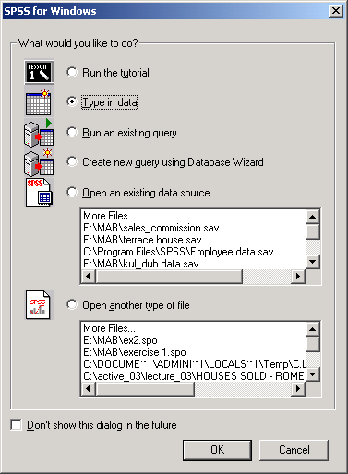
2.1 Introduction to SPSS
If you are
Creating a new data file, choose Type in data and OK
Opening an SPSS data file, choose Open an existing data source and OK
Assessing other databases (Access, SAS, Dbase, etc), choose Query or Database Wizard and OK
You can also choose Cancel to go directly to the Data Editor Window and create or open data files from that window.

Slide 11
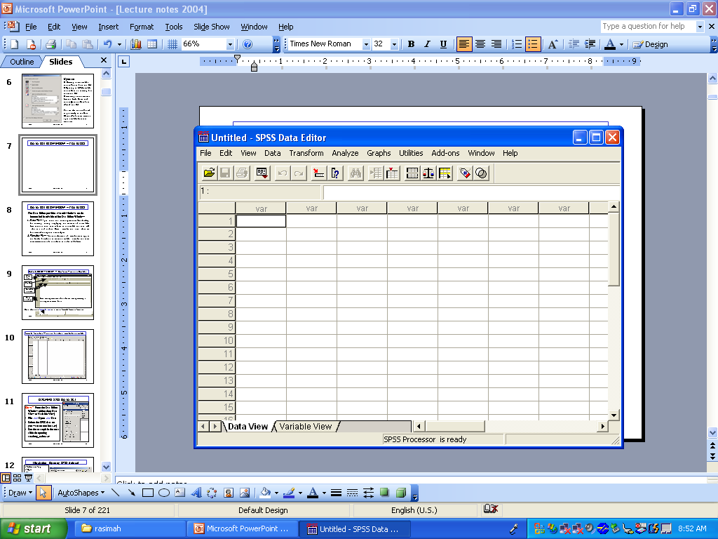
Data Editor Window - Features
2.1 Introduction to SPSS

Slide 12
Data Editor Window - Features
2.1 Introduction to SPSS
The Data Editor provides two sub-windows on the bottom left hand-side of the Data Editor Window:
Data View - provides a convenient spreadsheet-like facility for entering, editing, and displaying the contents of a data file. Each row is a case, each column is a variable and each cell value is a data value. Cases, variables and data values are fundamental concepts in data analysis
Variable View - for the definition of variable names, types and labels. Therefore, to create a data file, variables and their characteristics should be defined in the Variable View. You can also edit definitions of variables in this view.

Slide 13
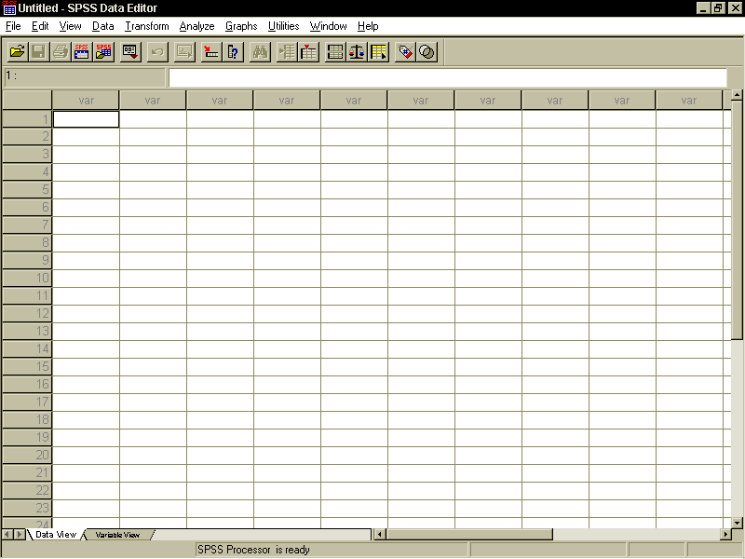
2.1 Introduction to SPSS
DATA EDITOR WINDOW – Data View Without a Data file
Menu bar
Tool bar
Variable names
Case numbers
Each case represents one line of information pertaining to one respondent/item/subject
Next, click on the Variable view tab to see the Variable View sub-window

Slide 14
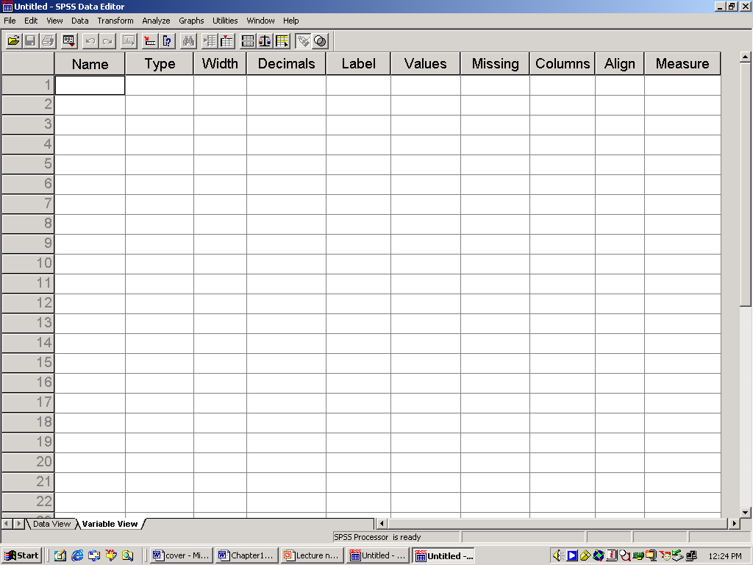
2.1 Introduction to SPSS
Variable View Sub-Window: To define variables for a data file
Name, Type of variables and width must be specified. The other columns are usually optional but in some cases are also necessary

Slide 15
Type of Data File Accessible by SPSS
2.1 Introduction to SPSS
SPSS data file (extension = sav) – directly using File>>>Open>>> Data…
Excel data file (extension = xls) – directly using File>>>Open>>> Data…
Text file (extension = dat or txt) – by direct conversion: File>>>Read Text Data…
Other databases such as Systat, SAS, S-Plus, dBase, Microstrategy and Access – by Database conversion: File>>>Open Database>>>New Query…

Slide 16
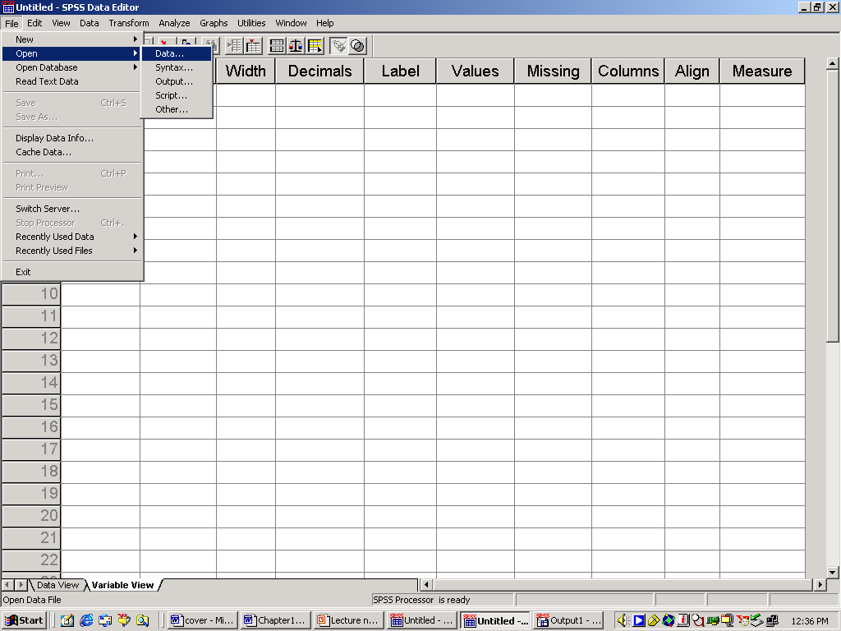
2.2 OPENING SPSS DATA SET
Chapter 2: Preparing Data for Analysis
How? From the Data Editor Window (either from Data View or Variable View)
File >>> Open >>> Data
Select the SPSS data set you want (extension sav)
See the example in the next slide for opening Smoking Habit.sav
The data file contains information on the smoking habit and other personal information of a random sample of 200 employees of financial institutions selected at random.

Slide 17
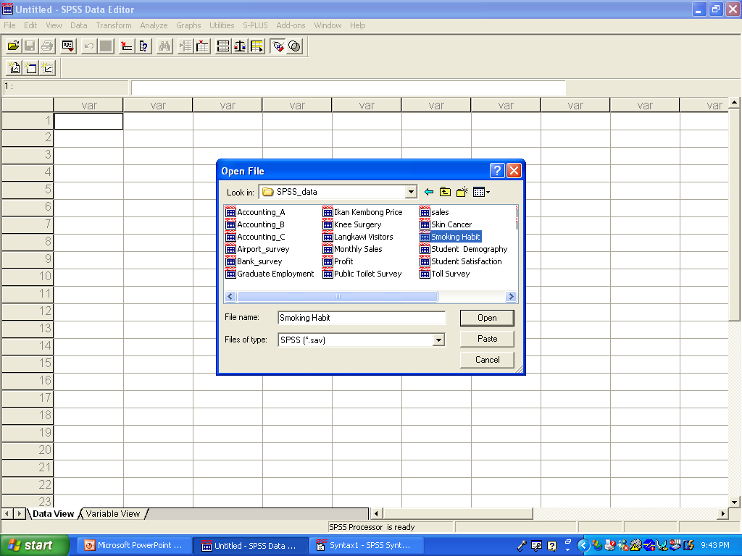
Opening SPSS data set: Illustration
2.2 Opening and Editing SPSS Data Set
Open the file from your CD/diskette in the folder SPSS Data
Select Smoking Habit
Open
See the data in the next slide
Note that
There are 8 variables
There are 200 observations or cases (scroll down to the end of the data lines)

Slide 18
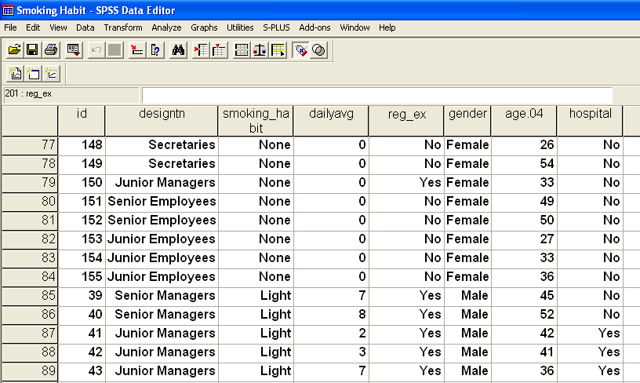
2.2 Opening and Editing SPSS Data Set
Smoking Habit Data Set

Slide 19
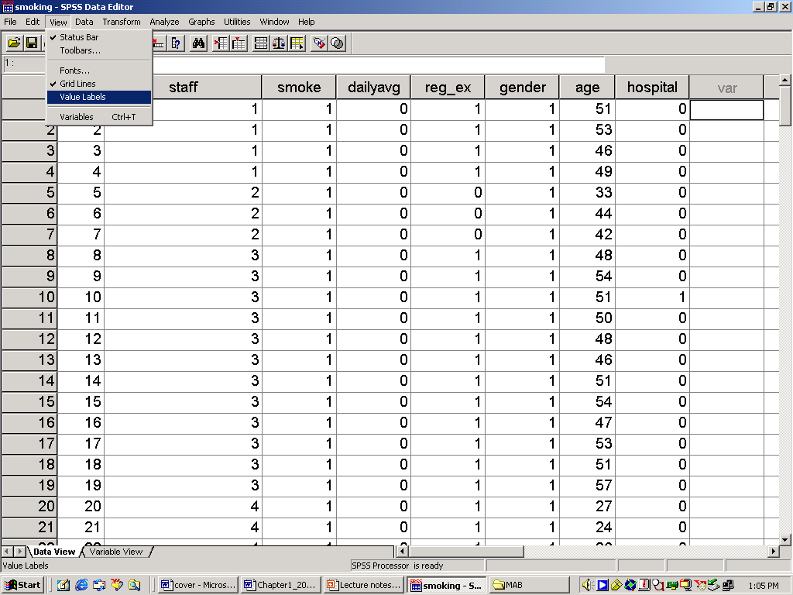
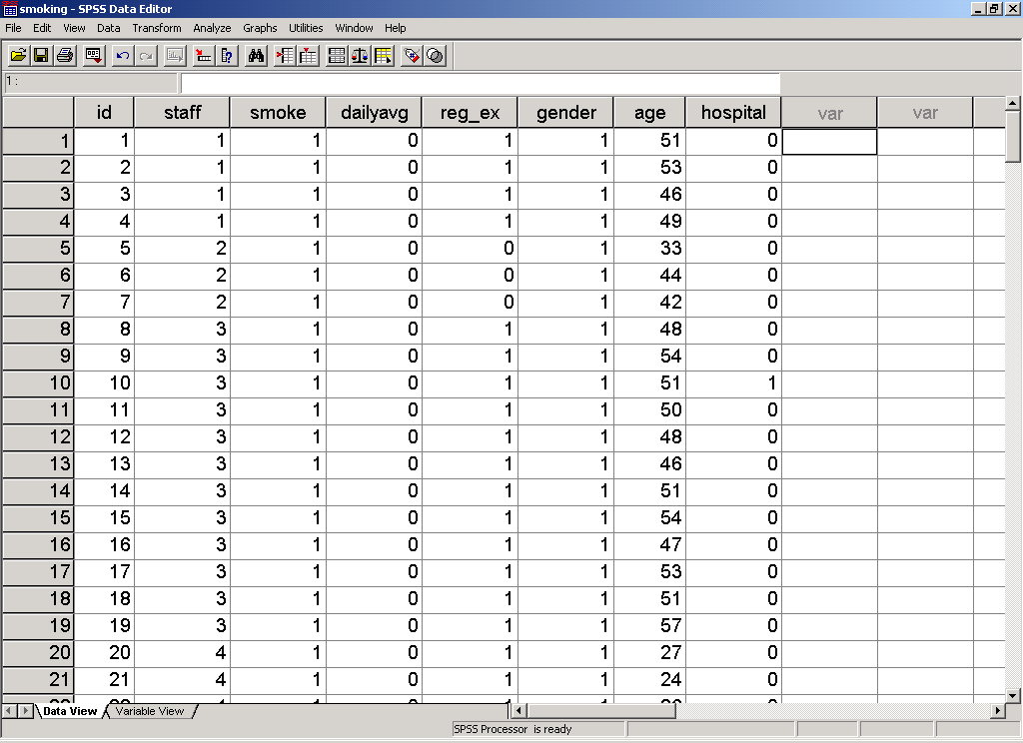
Data Editor Window: View Options
2.2 Opening and Editing SPSS Data Set
Categorical variables are displayed in the form of labels (Male/Female, Yes/No, etc)
To see coded values (1,2, etc) instead of labeled values, select
View >>>Value Labels (to deselect the label option)
Under View Option, you can also change the font type and size (Fonts…), go to the Variable View (Variables), and create new toolbars (Toolbars..)

Slide 20
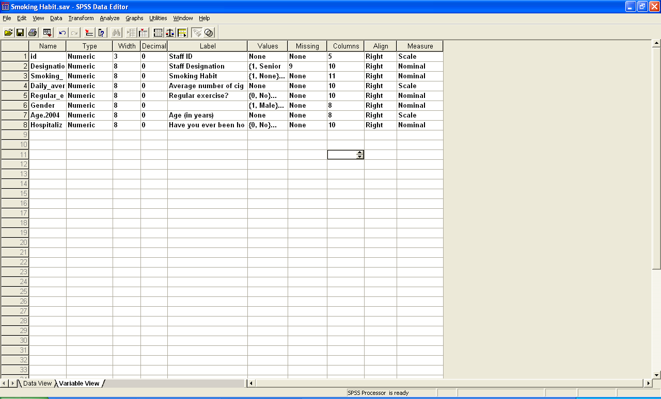
Variable View: Description of the Variables
2.2 Opening and Editing SPSS Data Set
Click the Variable View Tab (or View>>>Variables)
Note: All variables are defined as numeric even though not all are ratio/interval variables. This is because many procedures in SPSS require numeric codes instead of string categories as input (e.g. male, female). However, the codes must be labeled for easy reference (see the column Values)

Slide 21
Variable View: Names of variables
2.2 Opening and Editing SPSS Data Set
Rules on naming the variables :
Each variable name is unique, i.e. no duplication is allowed.
The length of the variable can be between 1 to 64 characters.
The name must begin with a letter and the remaining characters can be any letter, any digit, a period, or the symbols @, #, _ or $.
Cannot end with a period.
Cannot contain blanks or special characters such as: !, ?, &, (, ) and *.
Can be a mixture of uppercase and lowercase letters.
Cannot use reserved words: ALL, AND, BY, EQ, GE, GT, LE, LT, NE, NOT, OR, TO, and WITH.

Slide 22
Variable Names: Examples of valid and invalid names
2.2 Opening and Editing SPSS Data Set
Valid Variable Name | Invalid Variable Name
X DateOfBirth Toll_Rate New_IC_No Email@ Item# AlamatSuratMenyurat INCOME1990$ INCOME.1990 Section10_a_i | Nama Ibu not and Age<40 Section10(a)(iii) IncomeHusband&Wife 2005TAX Agree? ALL Interest*Time

Slide 23
Variable Name: Class Exercise
2.2 Opening and Editing SPSS Data Set
Determine whether the following variables names are valid in SPSS or not. If not valid, state the reason:
ProfitORLoss
Section2.a.i.
Marital Status
LevelOfSatisfaction
NoOfSharesTraded
NAMA PELAJAR
1990INCOME
Expenditure(RM)
Test1+Test2
Current_Address
Volume/Area
Question4(a)

Slide 24
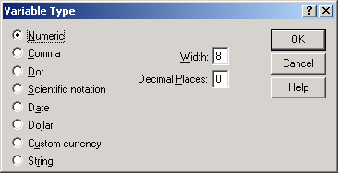
Variable View: Type of Data (Column 2)
2.2 Opening and Editing SPSS Data Set
Click the cell in Column 2 corresponding to the variable Age.2004 to get the pull down menu denoted by … to access the Variable Type dialog-box which shows the types of variables which can be defined. The current variable is numeric with data width equals 8 digits with no decimal point

Slide 25
Variable View: Width (Column 3)
2.2 Opening and Editing SPSS Data Set
The number of spaces reserved for the variable values. For numeric variables, the width is usually 1 to 8. For string variables, such as names, address, and ic number, allocate the maximum number of possible spaces required.
For instance, Smoking Habit is coded 1 (None) to 4 (Heavy). Hence, only one digit is needed to store the data value.
For illustration: Click the Width cell for Smoking Habit and change the value from 8 to 1. Do the rest according to the following:
Designation = 1; Daily_Average = 2; Regular_ex = 1; Gender =1; Hospitalization = 1. Leave the width for ID and Age.2004
Save the edited file as Smoking Habit Edited

Slide 26
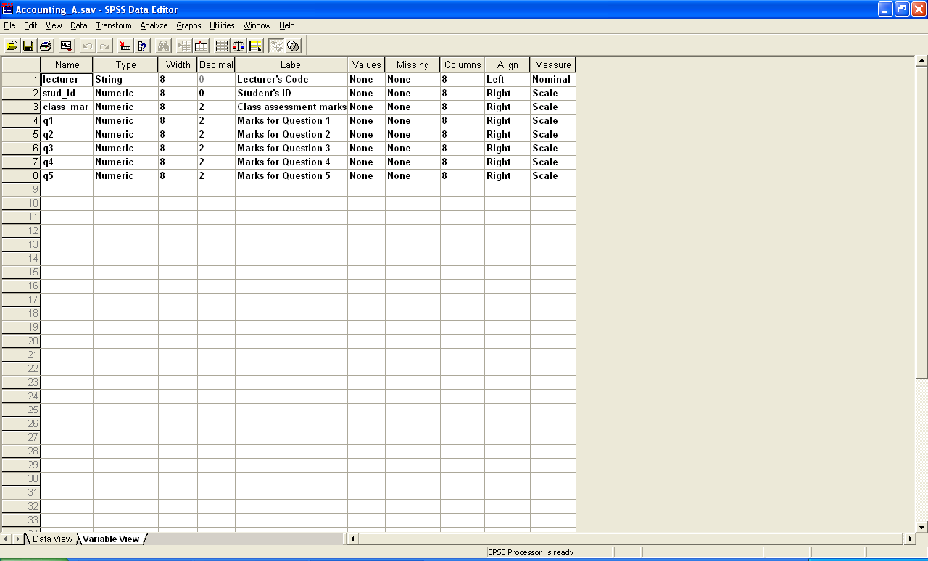
Variable View: Decimal (Column 4)
2.2 Opening and Editing SPSS Data Set
The number of decimal places needed can be controlled. For the Smoking Habit data set, all of the variables are either coded or discrete (age and number of cigarettes), hence, none of them requires any decimals.
To see the use of decimal places, open the data set Accounting_A.sav. Note that the variable values for class_mark, q1 to q5 are rounded off to two decimal places.

Slide 27
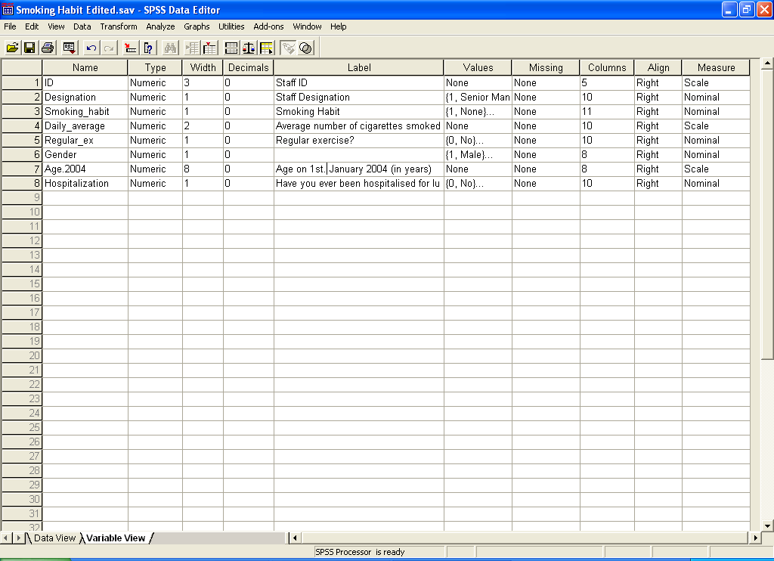
Variable View: Labels (Column 5)
2.2 Opening and Editing SPSS Data Set
Labels are provided to make the variable names more informative.
For instance, add the label for the variable Age.2004 as Age on 1st. January 2004 (in years)

Slide 28
Variable View: Values (Column 6)
2.2 Opening and Editing SPSS Data Set
To label the codes given to the data values. Only for categorical (qualitative) variables such as nominal (gender, ethnicity, urban/rural, states)
To see the labels for the variable Smoking_habit, click the respective cell pull-down dots … to get the Value Labels dialog box
You can change labels, remove or add new labels any time by selecting the respective options (add, change or remove)
For example, change the Value Labels for smoking habit from 1=None to 1 = Non-smoker (see the next slide for the results)
Add another code for the variable hospital: 0 = No Response

Slide 29
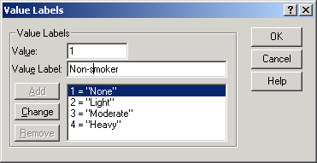
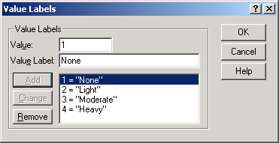
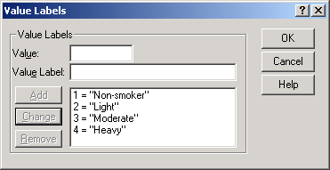
To change Value Labels- Illustration
2.2 Opening and Editing SPSS Data Set
Change to ‘Non-smoker’
Select Change
Select 1=‘None’

Slide 30
Variable View: Missing Values Definition (Column 7)
2.2 Opening and Editing SPSS Data Set
Missing values need to be declared to ensure that they are appropriately categorized, or excluded in computations and analysis
Missing values can be indicated by various values, such as 0, negative values, 99, or a range of value, such as 0 to 99.
Possible sources of missing values: No response/observations, or not applicable
SPSS allows 3 different codes to indicate discrete missing values; or a range plus one discrete value (for numeric variables only)

Slide 31
Missing Values Definition (Cont.)
2.2 Opening and Editing SPSS Data Set
The variable dailyavg, requires two missing values.
the value 0 is a missing value to indicate the not applicable case for non-smokers.
Other numbers such as -1 can be used instead to represent the missing values for the smokers who do not provide the value for dailyavg. See observations with id=91 and 94. Note that . = system missing value indicator is generated by the system when no values are entered.
Click the missing cell corresponding to the variable dailyavg. Key-in the numbers 0 and -1
Then, replace the system missing for id 91 and 94 by -1
The missing values can be labeled appropriately in the Value column (see the next two slides)

Slide 32
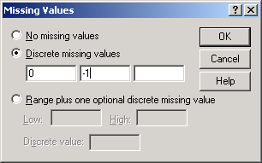
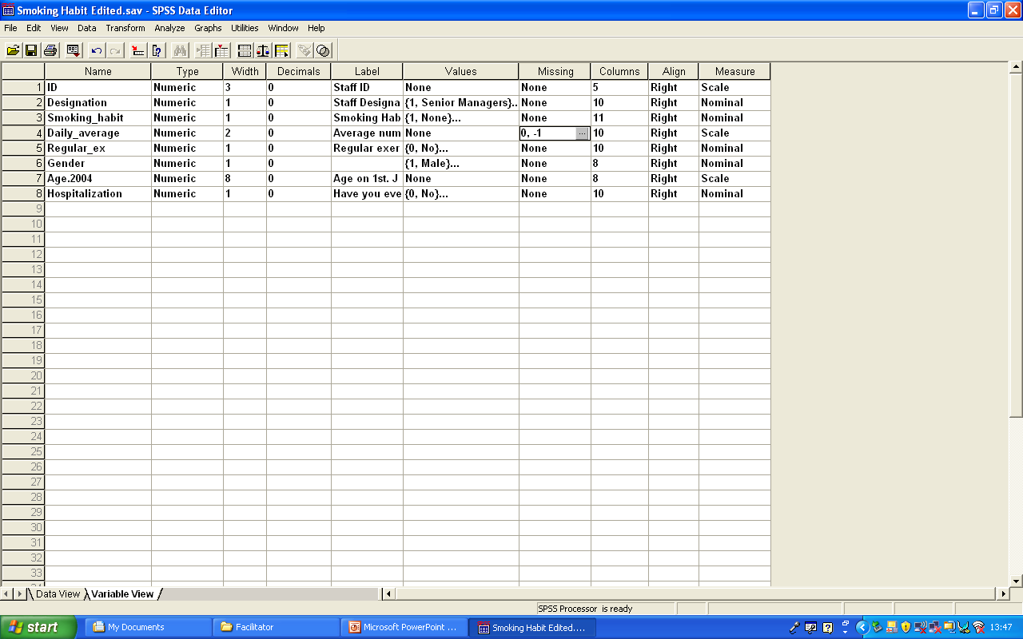
Missing Values Definition (Cont.)
2.2 Opening and Editing SPSS Data Set
Click OK

Slide 33
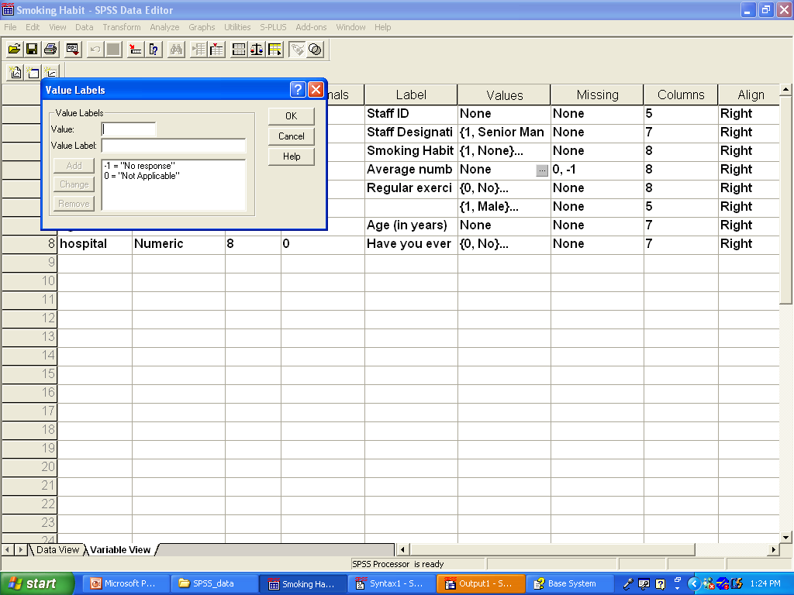
Labels for Missing Value Codes
2.2 Opening and Editing SPSS Data Set

Slide 34
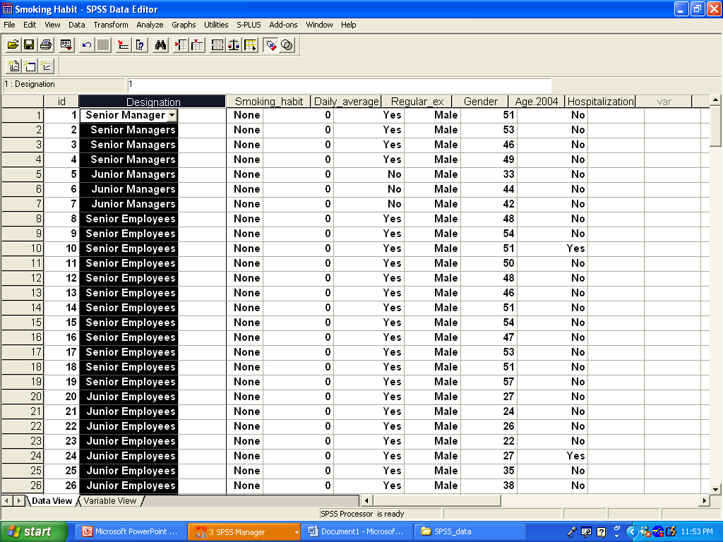
Variable Value: Column (Column 8)
2.2 Opening and Editing SPSS Data Set
Purpose: To set the number of columns for viewing
The number of columns can be more than the width
The width can be changed by changing the number of columns or changing the column margins on the data editor by pulling the respective right margin to the right.
Increase the margin by holding the right-hand button of the mouse and drag the right margin to the right

Slide 35
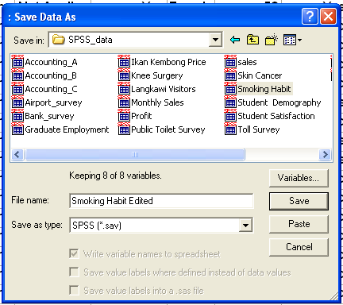
Saving a data set after editing
2.2 Opening and Editing SPSS Data Set
To save
File >>> Save to overwrite the old file
File >>> Save Data As to save as another file or to save for the first time
For example, to save the edited smoking data set as Smoking Habit Edited in your selected folder, refer to the Save Data As dialog box shown.
Click Save

Slide 36
Editing Data Set: Class Exercise
2.2 Opening and Editing SPSS Data Set
Open the data set Langkawi Visitors.sav
Note that there are 9 variables in the data set
The codes for the variable Purpose have not been provided.
Label the codes as follows:
1 = Holiday/vacation
2 = Shopping
3 = Visit relatives/Friends
4 = Conference/Meeting
5 = Business
6 = Others
Save the edited file using the same name.

Slide 37
2.3: Customizing Your SPSS Session
Chapter 2: Preparing Data for Analysis
Before starting a new SPSS session, you can change certain default options to suit your needs. Among them are:
The number of decimal places for numeric variables
The variable list or variable label list
The pivot table looks and format
Fonts for output tables
Currencies other than US$ (for example, RM, AUD$, etc)

Slide 38
Illustration
2.3 Customizing Your SPSS Session
Illustration:
First remove any data sets on the Data Editor Window as follows: File >>> New>>>Data
Edit >>> Options
The General Options dialog box will be displayed (see next slide)
You can change the default of other options by selecting the respective tabs (example: Data, Currency, etc.).

Slide 39
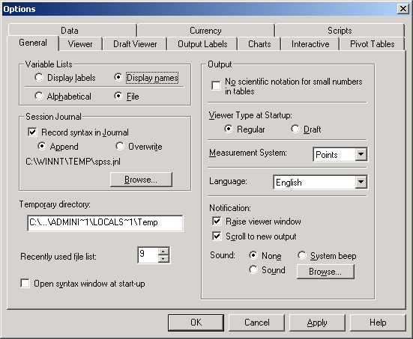
2.3 Customizing Your SPSS Session
Variable Lists
Make sure that Display names and File are selected to ensure the variables are listed in order of the variable names. Useful when there are many variables
Data Tab
Click on the data tab to make changes to how the data is to be displayed (see next slide)

Slide 40
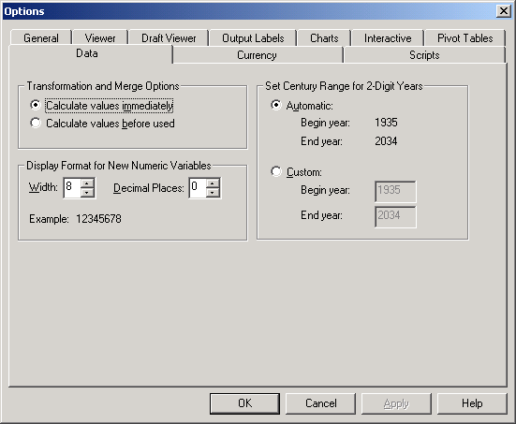
2.3 Customizing Your SPSS Session
Data Tab
Change the Decimal Places to 0 if most of your variables are codes. Manual changes can still be done on the Data Editor Window

Slide 41
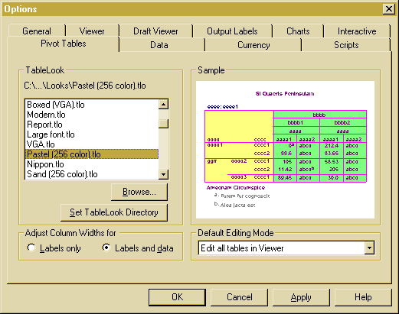
2.3 Customizing Your SPSS Session
To Set Default Pivot Tables
Tables produced from Reports, Summary Statistics and Tables Options and other analysis can be customised in terms of looks. For instance, to change from the default look to a Pastel, select as follows:
Edit >>> Options >>> Pivot Tables >>>Pastel

Slide 42
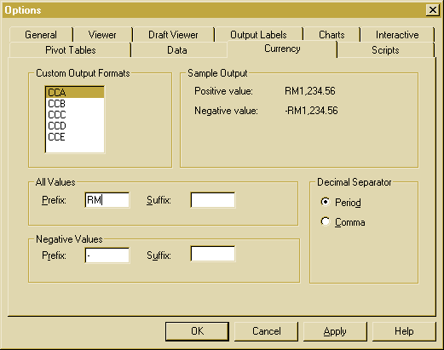
2.3 Customizing Your SPSS Session
Currency Prefix To see the symbol RM or other currencies appear in currency data, select the Currency Tab in the Options Dialog Box as shown. Click on CCA
Type RM in the Prefix box. You can set 5 currency symbols at one time by defining using CCA, CCB…, and selecting them accordingly during data file creation. For example, select CCB and set B$ (Brunei $)

Slide 43
2.4 Creating a New Data File: Class Illustration
Chapter 2: Preparing Data for Analysis
1. Refer to the questionnaire in Appendix 4 and create a data file to capture the information from the questionnaire.
2. If you already have a data set on the Data Editor Window, close the data file as follows
File >>> New >>> Data
2. To start creating your data set, do as follows:
a) Open the Variable View Sub-Window
b) Define your variable names, labels, and other required details.
For class exercise, create a data set based on the four completed questionnaires, provided in Appendix 4.
After creating the data file save the file as health_info. sav.
Switch to Data View Sub-Window and key-in the data from the questionnaire and Save.

Slide 44
Class Exercise (Cont…)
2.4 Creating a New SPSS Data File
Note that:
There are 9 variables to be defined. Even though serial number and name are not for analysis, they have to be defined as they are needed for the purpose of data checking and editing.
Define the variable names (remember the rules on naming variables); label them and define value labels appropriately.
Since there are possibilities of missing values for all variables, use 0 for non response for coded variables such as gender.
For Question 8 use -1 (no response) and -2 (not applicable) since 0 is a valid value.
Suggested definitions are on Slide. You can use your own definitions for name and labels.

Slide 45
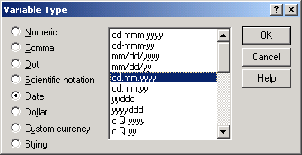
Variable Type
2.4 Creating a New SPSS Data File
To create a date variable for Question 1 (DOB = Date of Birth), refer to the following dialog box. Click the Type cell, then select the data display desired.
month.day.year
day.month.year

Slide 46
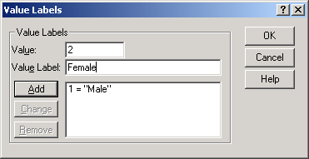
Data Value Labels
2.4 Creating a New SPSS Data File
To create the data value labels for Question 2 (Gender), click the corresponding Value cell and define the following labels: 1= Male; 2 = Female; 0 = No response:
Click add after every definition

Slide 47
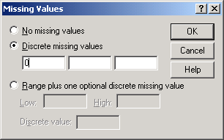
Setting Missing Values
2.4 Creating a New SPSS Data File
Define missing value=0 (No response) for Gender using the dialog box below:
For Question 8, 0 is not a missing value. Instead, define 2 missing values to differentiate between no response and not applicable : -1=NR; -2=NA
Click OK

Slide 48
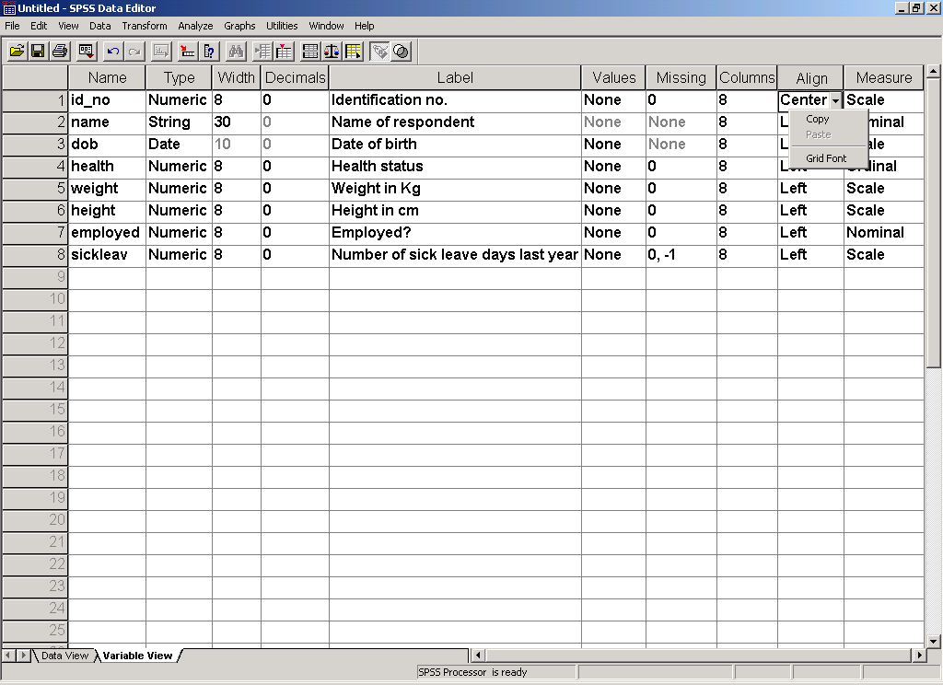
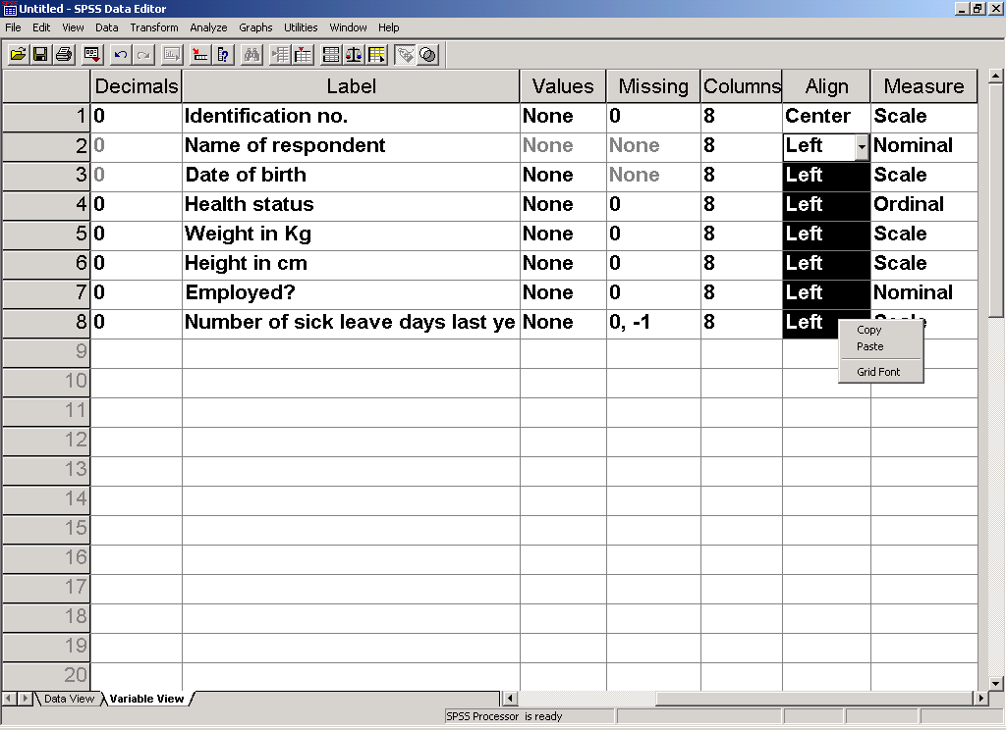
Cut and Save Option
2.4 Creating a New SPSS Data File
You can save time by copying a cell and paste to other cells with the same definition, for example, the number of decimal places, missing values or Alignment.
Point to any cell or the whole row to be copied and press the right hand button of your mouse to copy or paste. However, variable names cannot be copied and pasted as they must be unique.

Slide 49
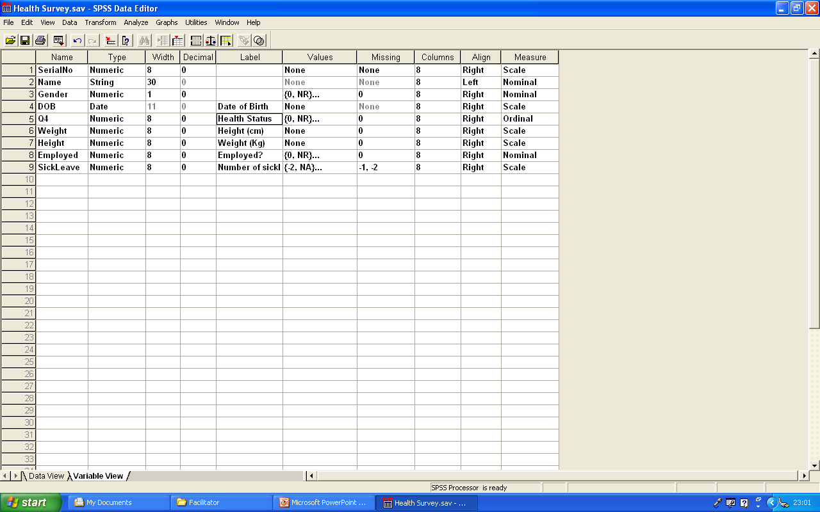
2.4 Creating a New SPSS Data File
The Variable View after all variables are defined

Slide 50
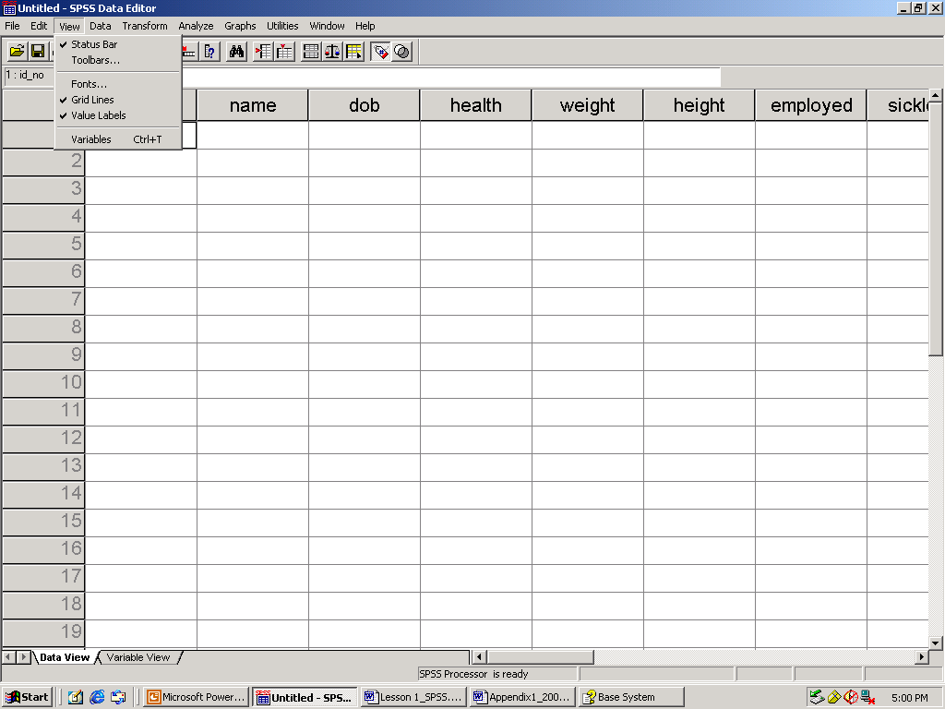
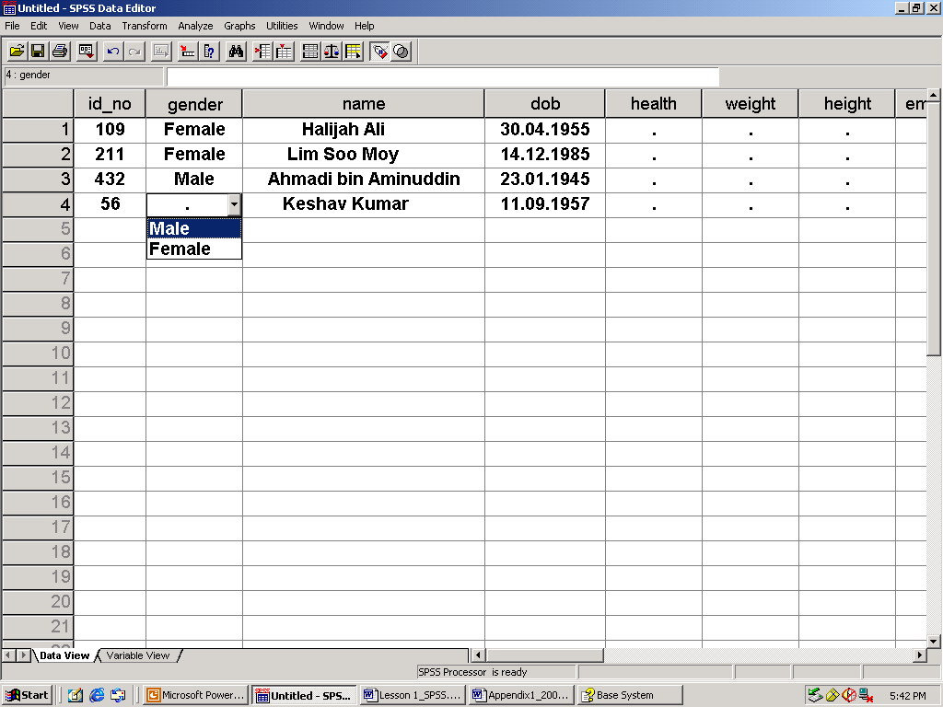
Keying-in the data values
2.4 Creating a New SPSS Data File
Switch to Data Value Window.
Ensure Value Labels View is on.
For a variable with Value labels, use the pull-down. menu in each cell to select the appropriate data value.
For example: gender.
For the rest of the data values, type the respective values.

Slide 51
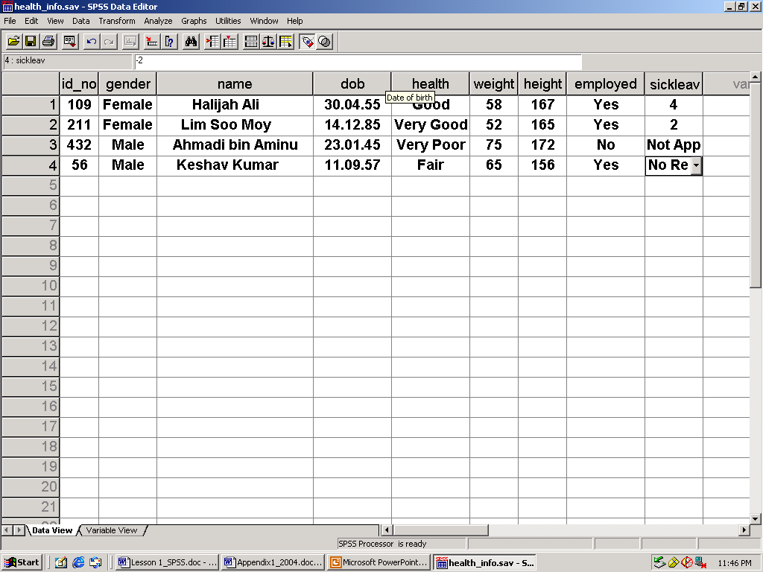
Data View (Value labels on)
2.4 Creating a New SPSS Data File
If the Value Labels option is on, the Data View Window should look like this after all the data values are keyed-in.
Save the data: File >>> Save As …

Slide 52
Class Exercise
2.4 Creating a New SPSS Data File
Refer to the observation sheet in Appendix 5. Read the description provided.
Create a data set to capture the information provided by the observation sheet
Save the file as Price of essential goods
Generate the file information and save it by giving appropriate names
Key-in the data for information collected from the four stores provided.
Save the data (Refer to Appendix 5(a) for the solution)

Slide 53
2.5: Other Data Management Options
Chapter 2: Preparing Data for Analysis
Display data file information – to generate documentation of the variables descriptions
To create a read-only file – to protect the data values from being changed unintentionally
Recently used data – a list of up to 9 recently used data files in the same session that you can reopen without using the File pull-down menu
Recently used file – a list of up to 9 recently used files in the same session (data, output, and syntax) that you can reopen without using the File pull-down menu.

Slide 54
Display Data File Information
2.5 Other Data Management Options
To see the listing of all variables in a data set:
File>>>Display Data File Information
Illustration: Open the data file health_info.sav created earlier. Do as (1) above.
See the next slide for a portion of the output in the SPSS Viewer Window .
The output can be printed directly as follows: File>>>Print
You can also save the output as health_info.spo. Note that the extension spo is the default for all output files.
The contents can also be copied and pasted into a Word document or a Power Point document

Slide 55
File Information Output: SPSS Viewer Window
2.5 Other Data-Related Options

Slide 56
File Information Output: SPSS Viewer Window
2.5 Other Data-Related Options
You can also save the output as health_info.spo or any name of your choice.
Note that the extension spo is the default extension for all output files.
The contents can also be copied and pasted into a Word document:
Edit>>>Select All
Edit>>>Copy objects
4. Paste in a Word file

Slide 57
Create a Read-Only Data File
2.5 Other Data-Related Options
Sometimes data values are deleted or changed by mistake during your SPSS session
If your data is already checked for errors and during the analysis stage you want to be sure that the original data values are not changed permanently, do the following
File >>> Mark File Read Only
However, the data values can be changed temporarily during the session but saving will be disallowed.
To release the Read Only option, do the following
File >>> Mark File Read Write

Slide 58
Recently Used Data and Files
2.5 Other Data-Related Options
If during your SPSS session, you had opened several data files, then the files are listed under the ‘Recently Used Data’.
To see the list or to reopen any of the data files, do as follows:
File >>> Recently Used Data
To see other files as well (such as output or syntax files)
File >>> Recently Used Files

Slide 59
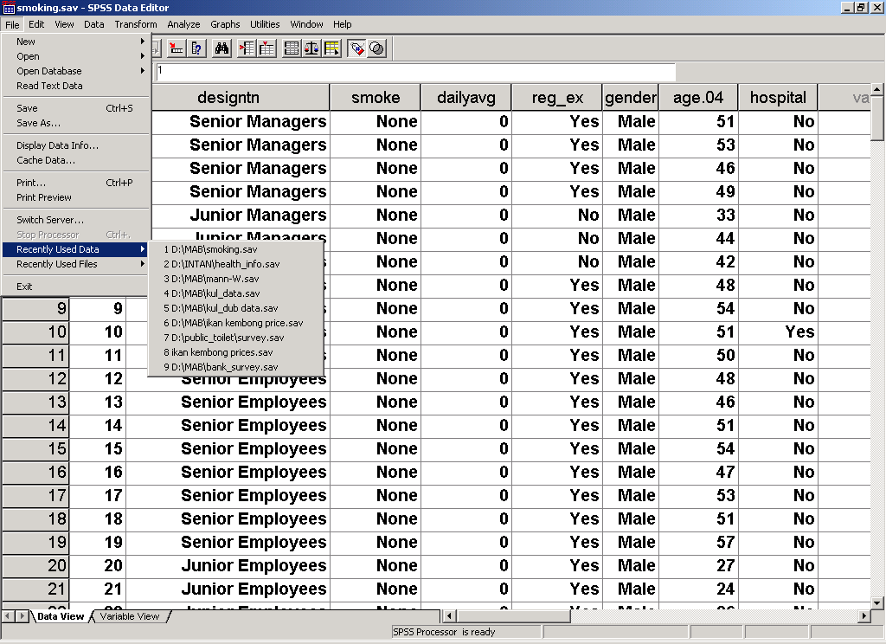
Recently Used Data List
2.5 Other Data-Related Options
List of 9 recently used data during the same session.
You can reduce the number of files to less than 9 under Options
Select the required file.
The Recently Used Files option list all types of files (data, output, etc)

Slide 60
2.6: Reading Excel Data Files
Chapter 2: Preparing Data for Analysis
SPSS can read Excel worksheets directly using the pull-down menu File >>> Open.
Note that, the Excel file can have multiple sheets but SPSS can only convert one worksheet at a time
It is advisable that the column labels (titles) follow the SPSS variable naming convention (Section 2.2), i.e. no blanks, not exceeding 64 characters, etc. Otherwise, SPSS will truncate the names or provided default names
No blank lines are permitted between data values and after or before the column labels (titles). Any blank lines would be assigned missing values for the respective variables.
Remove all main titles, comments or footnotes as SPSS only recognises variable names and data values.
Value labels need to be defined in SPSS and some other editing may need to be done after conversion

Slide 61
Illustration
2.6 Reading Excel Data
Refer to the Excel file Knowledge S&T.xls (description of each variable is in Appendix 7).
Open the file in Excel to see the contents (Next slide).
Note that:
There are three worksheets: Timur, Sabah_Sarawak, and Utara
the variable names are on the first line;
there are no empty lines in between the data lines;
the three sheets have the same variable names;
Some variable names do not follow the SPSS requirement
The data occupies the following cells: Timur = A2:J95; Sabah_Sarawak = A2:J391; and Utara = A2:J712

Slide 62
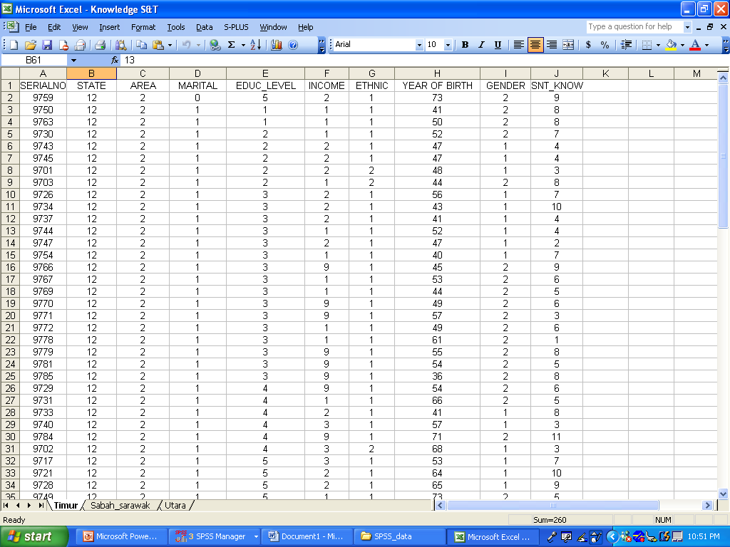
2.6 Reading Excel Data

Slide 63
Illustration
2.6 Reading Excel Data
To convert the file in SPSS, follow the following steps:
From the pull-down menus, choose File >>> Open…
From the Open File (next slide) dialog box, select the Excel file that you want to extract: Knowledge S&T.xls
Select the first of the three worksheets (Timur) available in the file.
Check whether all variables are correctly copied
Add appropriate labels for variable names and value labels (see Appendix 7 for the codes)
Save as S&T Timur.sav.

Slide 64
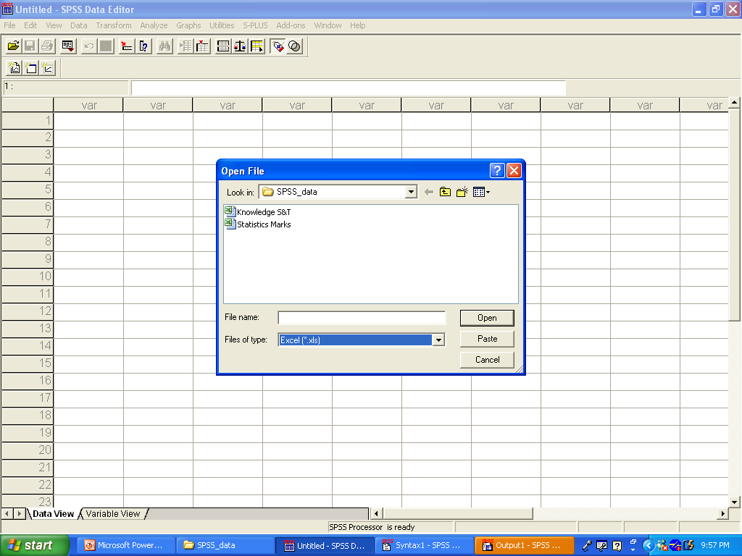
Illustration
2.6 Reading Excel Data
Select this file
Change to Excel

Slide 65
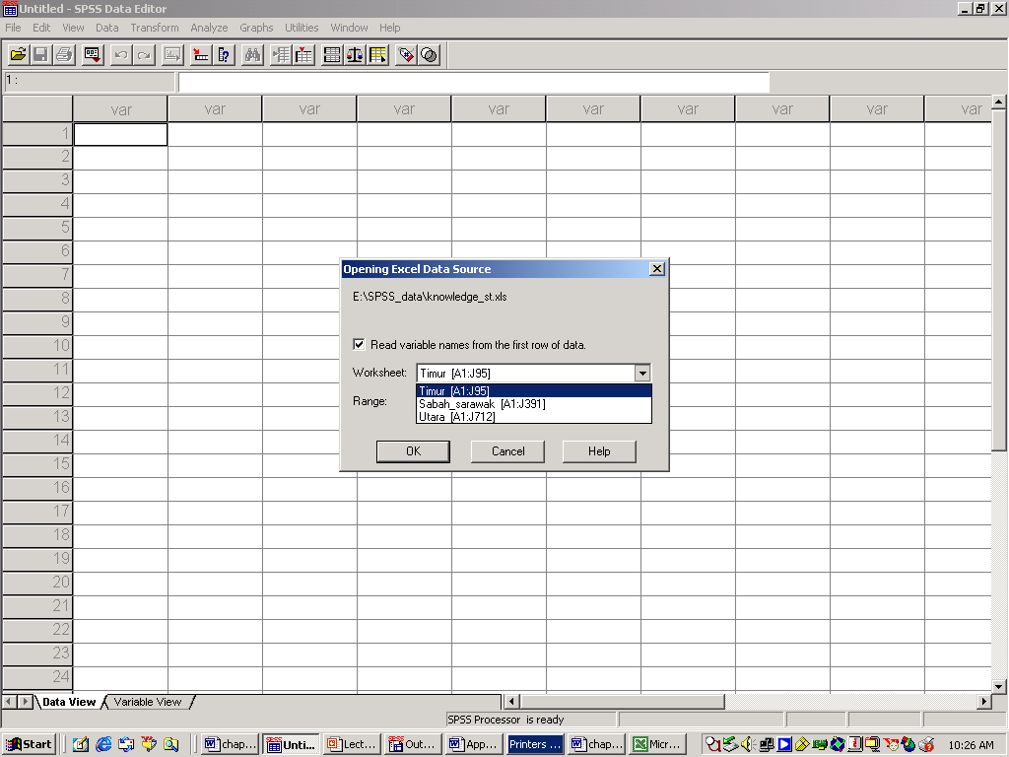
Illustration
2.6 Reading Excel Data
Select the first worksheet and click OK
Make sure the cell numbers (A1:J95) are the correct range for data conversion
See the next slide for the converted data file

Slide 66
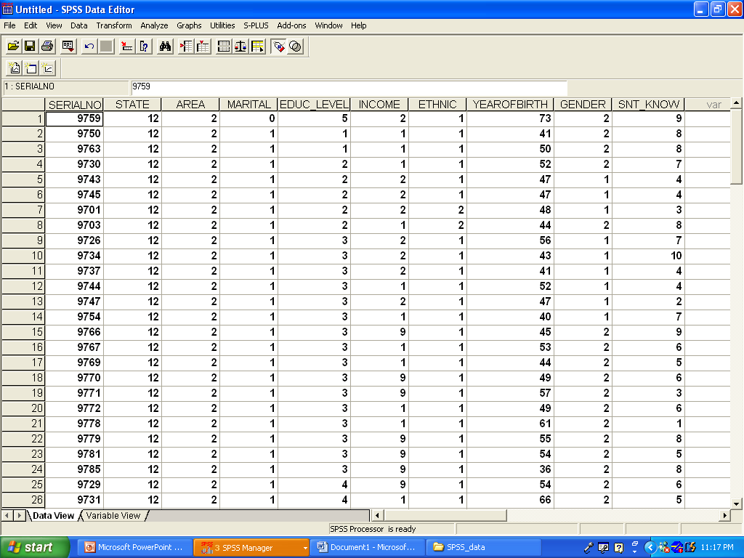
Illustration
2.6 Reading Excel Data
Note: The original Excel column labels for YEAR OF BIRTH is changed to YEAROFBIRTH to suit the SPSS naming rules.
Save the SPSS data file as S&T Timur.sav

Slide 67
Class Exercise
2.6 Reading Excel Data
Convert the other two worksheets from Knowledge S&T.xls.
Name the resulting SPSS files as S&T Sabah&Sarawak and S&T Utara, respectively.
Refer to the Excel file Statistics Marks.xls which contains the marks obtained by a group of students for three tests, 3 assignments, 2 quizzes and the final exam. The marks are keyed-in in three worksheets with the student's number as a common variable.
Convert each of the worksheet and name them as follows: Test; Assignment & quiz; and Final
Later, the three files should be merged as one file (See Section 3.5).

Slide 68
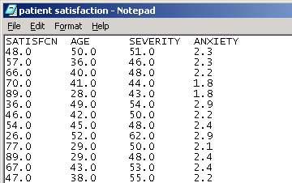
2.7: Reading Data From a Text File
2.7 Reading Data From a Text File
If your data are in text files (such as in Notepad or WordPad) you can convert to SPSS using the Read Text Data Wizard.
Example of a text file: patient satisfaction.txt. The file is in your diskette. Double click the file name to open it.
Note that the variables are separated only by blanks. Other separators (delimiters) such as ‘/’, ‘|’ or ‘,’ can also be used

Slide 69
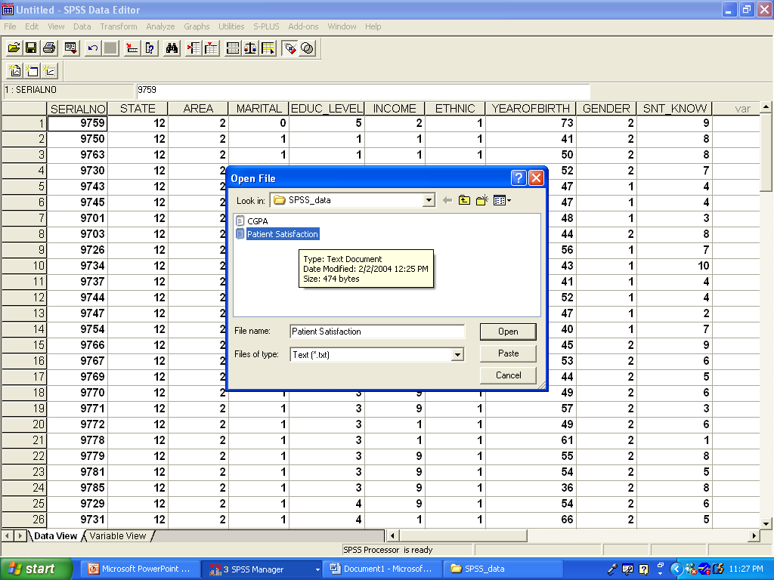
Reading Data From Text File - Illustration
2.7: Reading Data From a Text File
Click File>>> Read Text Data…
Select the file Patient Satisfaction from the dialog box
Follow the wizard (next three slides)

Slide 70
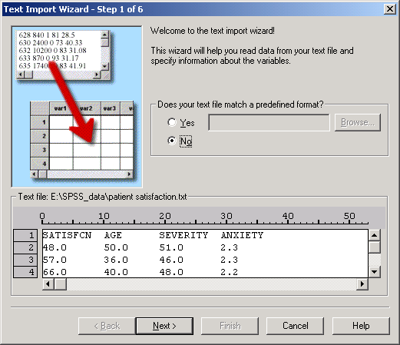
Illustration
2.7: Reading Data From a Text File
Check the data values and labels
Click Next

Slide 71
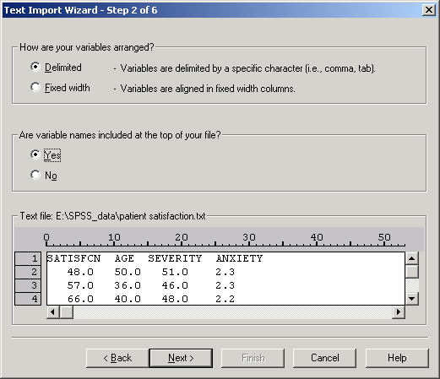
Illustration
2.7: Reading Data From a Text File
Check all the options
Click Next

Slide 72
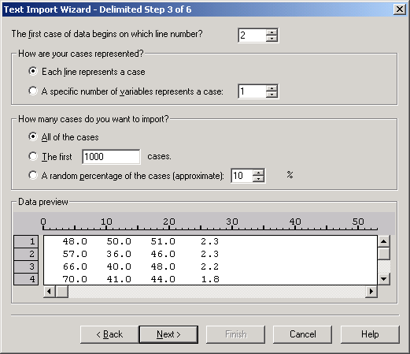
Illustration
2.7: Reading Data From a Text File
Check all the options
Click Next

Slide 73
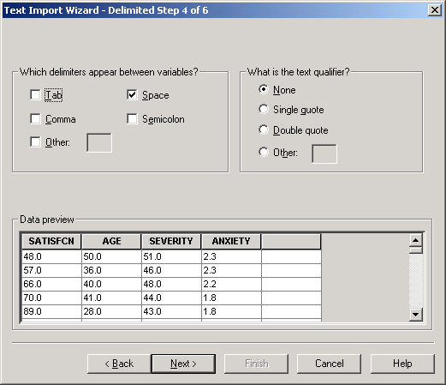
Illustration
2.7: Reading Data From a Text File
Check all the options
Click Next

Slide 74
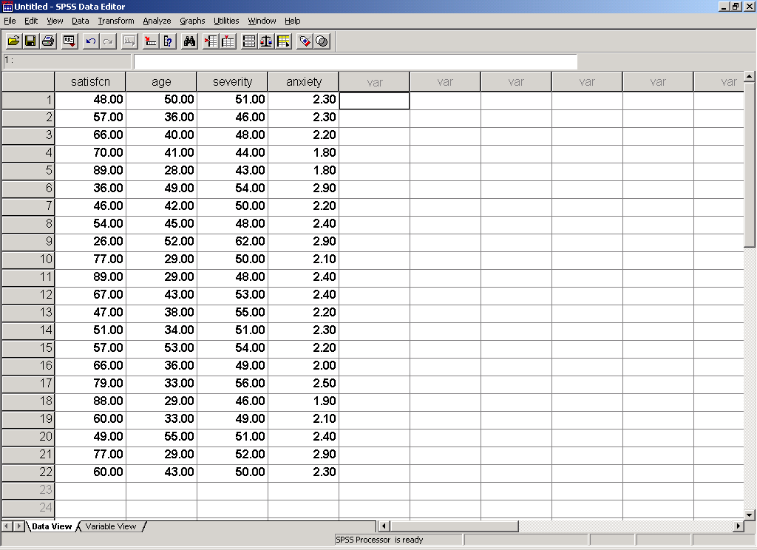
Illustration
2.7: Reading Data From a Text File
The resulting SPSS Data Set. Save as Patient Satisfaction.sav

Slide 75
Class Exercise
2.7: Reading Data From a Text File
Convert the data set CGPA.txt to SPSS data set (provided in your diskette)
Note that the delimiter is a slash (/).
Provide all variable and value labels.
Save as CGPA.sav
Get the File Information as a documentation
Save the File Information as CGPA.spo
CGPA/SCORE/GENDER
3.1/5.5/Male
2.3/4.8/Male
3.0/4.7/Male
2.9/3.9/Male
2.5/4.5/Male
3.7/6.2/Female
3.4/6.0/Female
2.6/5.2/Female
2.8/4.7/Male
2.6/4.3/Male

Slide 76
Chapter 3: Tools for Data Files Management
Data Management and Analysis Using SPSS for Windows
3.1 Detecting Data Errors Using Frequency Tables
3.2 Searching for Errors and Editing
3.3 Creating Temporary Subset of Cases
3.4 Creating Permanent Subset of Cases
3.5 Merging Several Data Sets
3.6 Aggregating Variables
3.7 Defining Weights for Summarised Data
3.8 Creating Time Series Data
3.9 Creating New Variables

Slide 77
3.1: Detecting Errors Using Frequency Tables
Chapter 3: Tools for Data Files Management
Frequency tables are useful to display the percentage distributions of cases by categories. For example, the distribution of respondents by gender, ethnic group, age-group, etc.
Hence, frequency tables are appropriate only for nominal or ordinal variables
To generate frequency tables:
Analyze >>>Descriptive Statistics>>>Frequencies…
From the dialog box (next slide) select the variables of interest and bring to the right-hand side panel

Slide 78
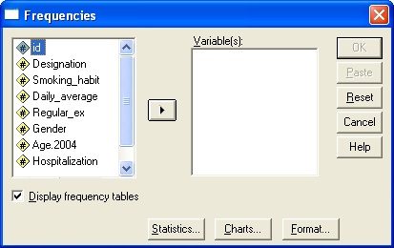
Illustration
3.1: Detecting Errors Using Frequency Tables
Open the Smoking Habit Edited data set.
Click on Designation and click the arrow to send to the selected variable(s) panel.
Then click OK

Slide 79
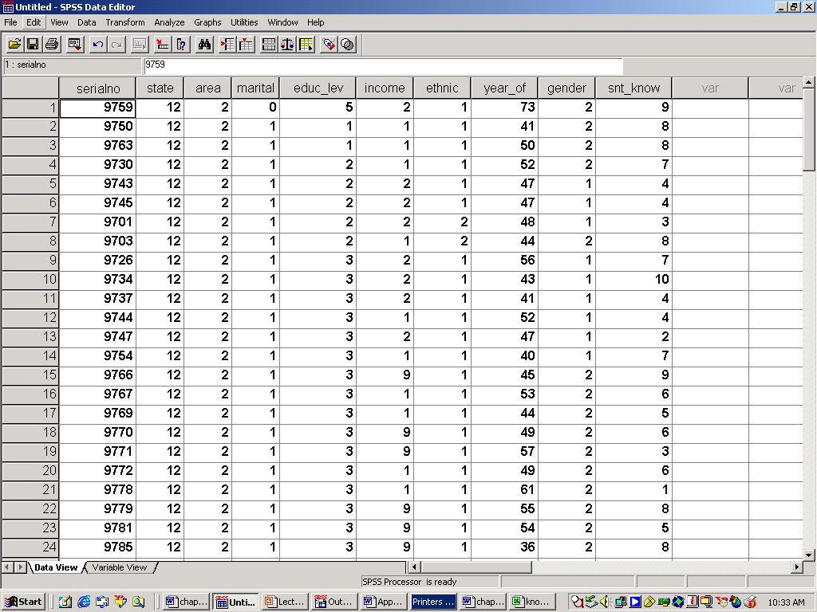
Illustration (Cont.)
3.1: Detecting Errors Using Frequency Tables
Note that one observation has an error for the variable Designation, i.e. value = 9 which is not one of the codes. To search for the errors, sort the variable Designation in ascending order or use the toolbar Find

Slide 80
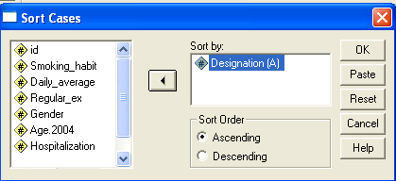
3.2: Searching for Errors and Editing
Chapter 3: Tools for Data Files Management
Use the Smoking Habit data set
From the pull-down menu, select
Data >>> Sort Cases… OK
Select Designation and Ascending (A)

Slide 81
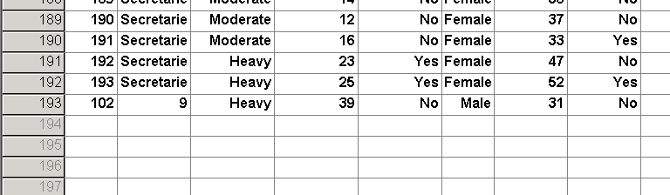
Sorting
3.2: Searching for Errors and Editing
Scroll the page to find the value 9 for the variable Designation
Change the value to 4 and then save the file again

Slide 82
Sorting (Cont.)
3.2: Searching for Errors and Editing
You can also use the toolbar to detect and correct errors as follows.
Click on the cell containing the variable name Designation
Click the toolbar
Key-in the value 9 and click Find next on the dialog box
Change the value 9 to 4.
See the next slide

Slide 83

Sorting (Cont.)
3.2: Searching for Errors and Editing
Click Designation column and click the Find icon
Type 9 and Find Next

Slide 84
Class Exercises
3.2: Searching for Errors and Editing
Open the Langkawi Visitors.sav data file
Generate a frequency table for the variables gender and marital (see the next slide)
Can you detect any errors in the data values for these two variables?
Search for the errors and make the following corrections:
Gender: Change all errors to Male
Marital: Change all errors to Married
Do not change the system missing values for marital. Save.

Slide 85
Class Exercise
3.2: Searching for Errors and Editing

Slide 86
3.3: Creating Temporary Subsets
Chapter 3: Tools for Data Files Management
One can restrict the analysis to a specific subgroup based on criteria that include variables and complex expressions without deleting any observations permanently.
A random sample of cases can also be selected to create new data files. The criteria used to define a subgroup can include:
Variable values and ranges
Date and time ranges
Case numbers
Arithmetic expressions
Logical expressions
Functions

Slide 87
Illustration: Selecting cases based on a single value
3.3: Creating Temporary Subsets
To select a subset of cases for analysis, from the menu choose:
Data >>> Select Cases…
This opens the Select Cases dialog box (see next slide).
For illustration:
Open the Graduate Employment.sav data set which contains information obtained from a survey of new graduates.
The data set contains selected information (8 variables) of a random sample of 1008 diploma and first degree graduates who have found employment.
Select only the Diploma graduates, level=1 (see the next slide)

Slide 88

Illustration (Cont…)
3.3: Creating Temporary Subsets
Select this button and click If…., and see the next slide for the dialog box
List of all variables

Slide 89

Illustration (Cont…)
3.3: Creating Temporary Subsets
Use the cursor and the calculator to define the equation, click Continue

Slide 90

Illustration (Cont…)
3.3: Creating Temporary Subsets
For temporary selection, select Filtered and click OK
Note that observations for level=2 are not deleted but merely crossed-out.

Slide 91

Illustration (Cont…)
3.3: Creating Temporary Subsets
Note that the variable filter_$ is generated to indicate the selected cases. The / on the case numbers indicates non-selected cases
Analysis is then carried out using only selected cases.

Slide 92

Selecting Cases Based on Conditional Expression
3.3: Creating Temporary Subsets
We might be interested to analyze only BSc. Science & Technology (S&T) graduates with beginning salary of more than RM2000 a month. See the Select Cases Dialog Box Below
Note, there are three variables used to filter the cases to meet the specification: Level, Area of Studies and Salary

Slide 93

Illustration: Conditional Expression
3.3: Creating Temporary Subsets
To see the content of the temporarily selected cases (select Filtered) do as follows:
Analyze >>> Reports >>> Case Summaries… OK
Select these variables for display

Slide 94
Displaying the contents of selected cases
3.3: Creating Temporary Subsets

Slide 95
3.4: Creating Permanent Subsets
Chapter 3: Tools for Data Files Management
To create a permanent data set from the main data set, follow the same procedure as for temporary subsets in previous slides but instead of specifying Filtered, select Deleted.
As an illustration, create a permanent data set for S&T diploma graduates only (see the next slide). Two variables need to be specified: Area of studies and Level of studies.
Save as Diploma S&T Graduates.sav in your SPSS_data directory. Do not use Save as this will overwrite the original file.
Note that the new data set Diploma S&T Graduates is now added to your directory

Slide 96

Permanent Subsets: Illustration
3.4: Creating Permanent Subsets
Area of studies=2 (S&T) and Level of studies=1 (Diploma).
Select Deleted.
A word of caution: It is advisable to use Filtered first and check that the selection is correctly done before using Deleted (use frequency table)
Save as – provide a new name

Slide 97
3.5: Merging Several Data Sets
Chapter 3: Tools for Data Files Management
It is quite a common practice to split large data sets into several files during the keying-in process. As a result several subsets of data files are obtained.
One reason is to speed up the data processing process by having several people keying-in the data simultaneously.
However, for the analysis stage, the separate files need to be merged.
There are two types of merging: Adding cases or adding variables
Adding cases is used when a data set is split by group of observations, such as by location of a study, type of houses or other characteristics (refer to knowledge S&T data).
Adding variables are used when a data set is split by groups of variables, such as demographic profiles section, opinion section, knowledge section, etc (refer to Statistics Marks data).

Slide 98
Adding Cases: Illustration
3.5: Merging Several data Sets
Use the accounting marks for three groups of students taught by three different lecturers: Accounting_A, Accounting_B and Accounting_C
The three files contain the same variables but for different cases. Therefore, merging is via adding cases.
First open one of the three data sets (for example, Accounting_A) on the Data Editor Window. It does not matter which one you open first.
Make sure all variables have the same name and definitions in all files. If there are differences, problems may arise during the merging process.

Slide 99


Adding Cases: Illustration
3.5: Merging Several data Sets
Click Data >>> Merge Files >>> Add Cases…
Select Accounting_B >>> Open

Slide 100

Adding Cases: Illustration
3.5: Merging Several data Sets
If all variables from both files match, then the dialog box should look like below, no Unpaired Variables. Click OK

Slide 101
Adding Cases: Illustration
3.5: Merging Several data Sets
Add Accounting_C. Save the merged data as Accounting_All.sav
The merged data set should have 736 observations.
Generate the following frequency table to check the success of the merging.

Slide 102
Adding Variables: Illustration
3.5: Merging Several data Sets
Sometimes data files are split according to sections or type of information.
For example, one file may contain the demographic profiles of the survey respondents, while another file contains their opinion on certain issues.
To merge such files, we can use the following:
Data >>> Merge Files >>> Add Variables…
For illustration, refer to the data sets: Student Demography which contains information on the demographic profile of a random sample of students taking part in a survey; and Student Satisfaction which contains the satisfaction ratings given by the same sample on selected issues

Slide 103

Adding Variables: Illustration
3.5: Merging Several data Sets
First open the file Student Demography on the Data Editor Window (4 variables).
Make sure the common variable, id is sorted in ascending order in both files.
Select Data >>> Merge Files >>> Add Variables…
Select Student Satisfaction (14 variables)

Slide 104

Adding Variables: Illustration
3.5: Merging Several data Sets
Note the Key Variable is siri which is provided by both files
Click OK
Save the merged data as Satisfaction Survey
The new data set should have 17 variables.

Slide 105
Class Exercises
3.5: Merging Several data Sets
Merge the three S&T data sets: S&T Utara, S&T Sabah&Sarawak and S&T Timur converted from the Excel worksheets. Make sure that the variable names are all the same. Name the merged file S&T All. Then generate a frequency table to see the distribution of respondents by State
Merge all three files containing the marks of students for the statistics course (Statistics Marks): Test; Assignment & quiz; and Final.
Save the merged file as Statistics Allmarks

Slide 106
3.6: Aggregating Data
Chapter 3: Tools for Data Files Management
Some variables need to be aggregated before any analysis can be done. This occurs when the information on a subject appears in sub-totals by selected variables.
One such example is the Quarterly Sales.sav data set in your diskette. Part of the data is shown on the next slide.
Note that the information on sales for each respondent are contained in 8 lines of observations, one line for each quarter and year, i.e. sub-totals by quarter.
Data aggregation for total sales can be done for each staff (staff_id), by year or over the two-year period.
To aggregate, select Data >>> Aggregate…
Aggregation measure can be, among others, the sum, mean, median, number of cases, maximum and minimum.

Slide 107

Illustration: Data set
3.6: Aggregating Data

Slide 108

Illustration: To compute total sales, 2002-2003
3.6: Aggregating Data
Select the two variables to aggregate by staff_id and name
Click Function to change from MEAN to SUM
Click Name & Label to change from sales_1 to tot_sale (Total sales, 2002-2003)
Click the File Tab to save the aggregated data as Sales_Total in your diskette.

Slide 109

Illustration (Cont.)
3.6: Aggregating Data
Select the SUM from the Function dialog box and Continue
Other functions can also be selected at the same time, such as minimum and maximum quarterly sales

Slide 110

Illustration: Variable name and label
3.6: Aggregating Data
Change the variable name and label and Continue

Slide 111

Illustration: Variable name and label
3.6: Aggregating Data

Slide 112

Illustration: (Cont.)
3.6: Aggregating Data
Open the file containing the aggregated data: Sales_Total.sav.

Slide 113

Class Exercise
3.6: Aggregating Data
For each sales personnel, find the mean quarterly sales for each year, together with the minimum and maximum quarterly sales. The aggregated data set should look like below.

Slide 114
3.7: Defining Weights for Summarised Data
Chapter 3: Tools for data Files Management
All previous data sets contain raw values for each variable, i.e. the variable values have not been summarised. That means the total number of observations/cases is equal to the number of lines of data.
Some data sets have summarised variable values such as in the form of total frequencies or observations.
Refer to the data set Fatal Accidents 2004 which contains information on the total number of fatal accidents in Malaysia by location throughout 2004. The total number of accidents is the sum of the data values of the variable NumberFatal, not the number of lines of data.
In the above, the weight have to be defined in order to ensure that the actual number of observations is used in the analysis.

Slide 115
Illustration: Fatal Accidents Data Set
3.7: Defining Weights for Summarised Data
Before weight is assigned, generate a frequency table for the type of vehicles
Note that the total number of vehicles for each type is only 6, which is not correct.
Therefore, define the weight variable as follows:
Data>>>Weight Cases… (see next slide)

Slide 116

Illustration: Fatal Accidents Data Set
3.7: Defining Weights for Summarised Data
The Weight Cases dialog box is as follows:
Select NumberFatal as the weight or the frequency variable
Generate a frequency table for the variable Type of Vehicle (see the next slide)

Slide 117
Illustration: Fatal Accidents Data Set
3.7: Defining Weights for Summarised Data
The correct number of vehicles weighted by the variable NumberFatal is shown below.

Slide 118
Class Exercise: Flavour Preference data set
3.7: Defining Weights for Summarised Data
If the number of cases are not weighted then the following frequency table is obtained for the variable Age:
Weigh the cases using the variable Number (the number of respondents). The correct table should be as below

Slide 119
3.8: Time Series Data
3.8: Time Series Data
The previous data sets (Graduate Employment, Smoking Habit and Langkawi Visitors) are called cross-section data as each subject is measured only once.
Another type of data is a time series data where a variable is observed at equal interval of time over a certain period of time
Examples are: Annual profit of a company for 30 years, daily maximum temperature in Kuala Lumpur for one year in 2004, monthly electricity bill of a factory over a 5-year period, Weekly toll collection at the Sg Besi toll plaza, etc.
When keying-in a time series data, you do not need to key-in the dates as it can be generated automatically after the variable values have been keyed-in

Slide 120

Illustration
3.8: Time Series Data
Refer to the Toothpaste data set which shows the monthly market share of two brands, Super White and Ultra Bright, from January 1982 to December 2004.
Generate the date for the data set as follows:
Data>>>Define Dates…
Set the year 1982 and Month=1
See the next slide for the dated data set.

Slide 121

Illustration
3.8: Time Series Data

Slide 122
Class Exercise
3.8: Time Series Data
Refer to the data set Toll Traffic which contains information on the number of vehicles passing through three toll plazas, every month during the period May 1987-December 2004.
Generate the date using the format Year, Quarter and Month
Refer to the resulting data set on the next slide
2. The data set SalesProfit is a time series of the quarterly sales and profit (in thousand RM) made by a pharmacy. Generate the dates for the data starting from the 3rd quarter of 1990. What is the last date for the data set?

Slide 123

Class Exercise (1): The resulting data set
3.8: Time Series Data

Slide 124
3.9: Creating New Variables
Chapter 3: Tools for data Files Management
Very often we need to create new variables from the raw data. Examples are totals, mean scores, percentage measures, transformed values such as logarithm, etc.
Data transformation procedures change the actual values of your variables or create a new variable.
Transformation affect only the working data files; the changes do not become permanent unless you save the working data files.
Two commonly used procedures are Compute and Recode.

Slide 125
Compute
3.9: Creating new variables
Compute calculates data values according to a precise expression using the existing quantitative variables in a data set.
You can assign the computed values to a new variable or you can assign them to the existing variable (replacing the current values). But the latter is not advisable as it may lead to errors.
Among the most commonly used functions are: MEAN = mean value of several variables; SUM = sum of several variables; RND = rounding off value; C.TIME = time interval; SUBSTRT = to read a string value from a string variable (example: To read the code for gender from IC number)

Slide 126
Compute: Illustration
3.9: Creating new variables
Use the data set Airport Survey which contains information from a survey of respondents using services at two airports: Airport A and Airport B.
We would like to compute the satisfaction level towards the airport services by taking the mean of all items evaluated. The details of each item is given in Appendix 8
Compute the mean rating for the airport as follows: AirportMean=MEAN(Q7a_findway to Q7t_ambiance)
Compute the mean rating for airline:
AirlineMean=MEAN(Q12a_alwtchin to Q12d_alounges)
Note: 0 is a missing value for all variables, hence will not be included in the computation of the mean ratings

Slide 127

COMPUTE: Illustration
3.9: Creating new variables
Select Transform >>> Compute…OK
Note: The function MEAN will compute the mean scores for all non-missing values for all variables in the range. Missing values are ignored

Slide 128

Compute: Illustration
3.9: Creating new variables
Change the decimal place to 2 and label the new variable: AirportMean as Mean score for airport ratings. Next, compute AirlineMean and label as Mean score for airline ratings

Slide 129

Compute: Class Exercise
3.9: Creating new variables
1. Refer to the data set Outpatient Clinic data set shown partially below. Compute the following
the waiting time in minutes as follows:
Waiting = CTIME.MINUTES(Served) – CTIME.MINUTES(Entered)
where Served = time service completed; Entered = Time entered the service queue

Slide 130
Compute: Class Exercise
3.9: Creating new variables
Refer to the data set Weight Loss which shows the weights of a group of participants who took part in a weight loss program. Compute the following:
The amount of weight loss during the six-month program
The percentage of weight loss during the six-month program
Refer to the data set Financial Report
Compute the change in sales in 2005 (increase or decrease) with respect to sales in 2004.
Compute the change in profits for 2005 relative to 2004.
Compute the percentage change for both sales and profits above

Slide 131
Recode: Creating Categories or New Codes
3.9: Creating new variables
Recode assigns discrete values to a variable, based solely on the present values of the variable being re-coded.
You can assign the re-coded values to the variable being re-coded, or you can assign them to a new variable.
Recode can be applied to convert quantitative variables to Categories or from Categories to Categories. The new variable can be numeric or string.
For example from Age (in years) to Age-Group (Ordinal); From State (Nominal) to Zone (Nominal); From system missing (.) to missing value code (for example, 0)

Slide 132
Recode: Illustration
3.9: Creating new variables
Refer to the data set Insurance Claim which contains information on the demographic variables and amount of claims made by insurance policy holders
Recode the age of the claimants into four groups using numeric codes and data values labels as follows:
1 = <21 years old
2 = 21-39 years old
3 = 40-59 years old
4 = 60 or older
Name the new variable AgeGroup
Follow the steps in the next slide

Slide 133

Recode: Illustration
3.9: Creating new variables
Transform >>> Recode >>> Into Different variables…
Follow the steps as indicated by the numbers 1 - 5
2
1
3
4
5

Slide 134

Recode: Illustration
3.9: Creating new variables
Define the four categories, Continue. See next slide

Slide 135

Recode: Illustration
3.9: Creating new variables
Go to Variable View Tab, define the value labels and see the next slide for the labels view

Slide 136

Recode: Illustration
3.9: Creating new variables

Slide 137
Class Exercises
3.9: Creating new variables
Refer to the Statistics_Allmarks.sav that you have created (Section 3.5).
1. Compute total marks obtained by each student as follows:
MARKSTOT = 30% of the average test score (MEANTEST) + 10% of assignment + quiz percentage score (ASSGQUIZ) + 60% of final examination score (FINAL_EX)
MEANTEST = MEAN(test1, test2, test3)
ASSGQUIZ = SUM(assg1, assg2, assg3, kuiz1, kuiz2)/75*100
MARKSTOT = 0.3*MEANTEST+0.1*ASSGQUIZ+0.6*FINAL_EX
Note: The total marks for Assignment and Quizzes = 75

Slide 138
Class Exercise (Cont.)
3.9: Creating new variables
2. Based on the total marks (MARKSTOT), assign grades (GRADE) as follows
<40 = F
40-49 = D
50-64 = C
65-74 = B
75 and above = A
3. Based on the variable GRADE, assign the status of the students (STATUS) as follows:
A to C = Pass
D to E = Need to repeat

Slide 139
SECTION II
Data Management and Analysis Using SPSS for Windows
EXPLORATORY DATA ANALYSIS

Slide 140
Chapter 4: Exploratory Data Analysis
Data Management and Analysis Using SPSS for Windows
4.1: Introduction: Strategy for Data Analysis
4.2: Presentation of Qualitative Variables
4.3: Graphical presentation of Quantitative Variables
4.4: Summary statistics: Measures of Central Tendency, Variability and Location
4.5: Reliability Test: To Test the reliability of a construct/dimension
4.6: Factor Analysis: To Identify Multi-dimensional Constructs from a Group of Variables

Slide 141
4.1: Strategy for Data Analysis
Chapter 4: Exploratory Data Analysis
Exploratory
QUALITATIVE
FREQUENCY
DISTRIBUTION
FOR EVERY VARIABLE
Inference
QUANTITATIVE
Percentage, mode, median, charts and tables (No measure for Variation)
DESCRIPTIVE
STATISTICS/CHARTS
Mean, median, variance, graphs, and many more
MEASURES OF
ASSOCIATION
Cross-tabulation, nonparametric measures of association
Correlation Analysis
HYPOTHESIS
TESTING/
MODELLING
Parametric
Methods
Non Parametric
Methods
ESTIMATION,
PREDICTION,
FORECASTING

Slide 142
Hierarchy of Data Analysis
4.1: Strategy for Data Analysis
Exploratory Data Analysis includes tabular and graphical presentations of data and summary statistics
For qualitative variables (such as gender, ethnic group and opinion), frequency tables, cross-tabulations and charts (pie chart and bar chart) are useful for understanding the basic features of the data collected.
For quantitative variables (such as income, profit and scores), summary statistics and plots (histogram, box plot and stem-and-leaf plot) are used for discovering basic sample characteristics.
For the initial information on relationships between variables, analysis of association and correlation can be carried out.

Slide 143
4.2: Presentation of Qualitative Variables
Chapter 4: Exploratory Data Analysis
Type of tabular presentation: Frequency (one-way table) and cross-tabulations (also known as two-way or contingency table)
Purpose: Other than for detecting errors discussed earlier, frequency tables present the distribution of cases by categories of one qualitative variable; while a cross-tab presents the distribution of cases by two variables
For illustration, refer to the Smoking Habit Edited data set and generate a table to show the distribution of respondents by their designation and smoking habit as follows:
Analyze >>> Descriptive Statistics >>> Frequencies…
See the next slide for the Frequencies Dialog Box
For each frequency table, describe the percentages

Slide 144

Simple Frequency Tables
4.2: Presentation of Qualitative Variables
You can select other categorical variables: reg_ex, gender, and hospital, but not dailyavg and age2004
Click OK
Options: You can specify a pie chart or bar chart to present the distribution and compute relevant summary statistics. These will be discussed in Section 4.3

Slide 145
Frequency Tables (Cont…)
4.2: Presentation of Qualitative Variables
Among the 200 respondents selected at random from several financial institutions, most of them were junior employees (47.5%), followed by senior employees who made up about one-quarter (25.5%) of the sample. Managers (senior and junior) and secretaries made up the rest of the sample (14.5% and 12.5%, respectively)

Slide 146
One-way frequency table: (Cont.)
4.2: Presentation of Qualitative Variables
Slightly more than half of the respondents are non smokers (51.0%). Slightly less than one-quarter (23.5%) are moderate smokers, followed by light smokers (17.5%). Less than 10% are heavy smokers (8.5%).
In order to see the distribution of smokers only by their degree of smoking habit (Light, Moderate and Heavy), select only smokers (Section 3.3) and generate a frequency table for Smoking Habit.
See the output in the next slide

Slide 147
One-Way Frequency Table (Cont.)
4.2: Presentation of Qualitative Variables
Among smokers, most of them (48.0%) were moderate smokers (smoked between 11 and 20 cigarettes per day)
The rest (35.7%) were either light smokers who smoked 10 or less per day) or heavy smokers (16.5%) who smoke more than 20 cigarettes per day

Slide 148

To Edit the Output Table
4.2: Presentation of Qualitative Variables
To edit the output table in the SPSS Viewer, double-click the table to be edited, then double-click the text that need to be changed.
For example to change the title, double-click the title Smoking Habit and write the following title over it:
Table 4.1: Distribution of smokers by degree

Slide 149
Frequency table: Class Exercises
4.2: Presentation of Qualitative Variables
Use the Airport Survey data which contains ratings of customers on services provided by Airport A and Airport B.
Generate frequency tables to present the distribution of respondents by purpose of their trip (purpose) and their flight class (class) for Airport A only. Select Airport = 1 first.
Based on the tables, describe the profile of the respondents
Note that since there are missing values, valid percent should be used instead of percent
Change the title of the table as follows:
Table 1: Distribution of Respondents at Airport A by Purpose of Trip
Table 2: Distribution of Respondents at Airport A by Flight Class
See the next slide for the results

Slide 150
Class Exercises: Output
4.2: Presentation of Qualitative Variables

Slide 151
Two-way frequency table (Cross-Tabulation)
4.2: Presentation of Qualitative Variables
Two-way frequency tables (cross-tabulation) presents the distribution of subjects in terms of counts or percentages by two categorical variables. Examples are:
the distribution of customers by gender and age-group
The number of cars sold by make (Proton, Perodua, etc) and state (Selangor, Perak, etc)
The percentage distribution of students by SPM Mathematics grade (A, B, C, P, F) and type of school attended (residential, non-residential)
The tables provide several statistics for comparative purposes between groups

Slide 152
Cross-tabulation: Illustration
4.2: Presentation of Qualitative Variables
Identify appropriate two-way frequency tables (cross-tabulation) to answer the following research questions using the Smoking Habit Edited data:
Is the proportion of male smokers higher than those among females?
Is there an indication that smokers face more risk of having lung-related problems?
Is smoking habit among staff related to the nature of their job (Designation)?
Is there a relationship between smoking habit and exercise habit?

Slide 153

Cross-Tabulation: Illustration
4.2: Presentation of Qualitative Variables
Analyze >>> Descriptive Statistics >>> Crosstabs…
Click Cells to select appropriate percentages (see next slide)

Slide 154

Cross-Tabulation: Illustration
4.2: Presentation of Qualitative Variables
Click Continue to go back to the Crosstabs dialog box.
Click OK

Slide 155
4.2: Presentation of Qualitative Variables
Q1: Is there an indication that the proportion of male smokers is higher than those among females?
Majority among females (69.3%) do not smoke. In contrast, the majority among males (63.3%) are smokers.
Also, there are no heavy smokers among females compared to almost 14.3% among males.
The above are indications that smoking habits differ between males and females
Note: Only percentages within Gender (Column) needed to be compared

Slide 156
Cross Tabulations: Class Exercise
4.2: Presentation of Qualitative Variables
Generate relevant tables to answer the following questions using the Smoking Habit data set. See the outputs on the next two slides.
Does smoking habit differ between those who exercise regularly and those who do not?
Is there an indication that smokers face more risk of having lung-related problems?
See the next two slides for the output

Slide 157
Q: Does smoking habit differ between those who exercise regularly and those who do not?
4.2: Presentation of Qualitative Variables
Majority (67.9%) among those who exercise regularly do not smoke. In contrast, less than 30% (29.8%) among those who do not exercise regularly are non-smokers

Slide 158
4.2: Presentation of Qualitative Variables
Q: Is there an indication that smokers face more risk of having lung-related problems?
The proportions among smokers who have been hospitalized for lung-related problems increases as the number of cigarettes smoked increases (ranging from 22.5% to 55.6%). Only 15.5% among non-smokers have been hospitalized.

Slide 159
Graphical Presentation: Pie Chart
4.2: Presentation of Qualitative Variables
Suitable for
Single categorical variable
No comparison between groups
Not suitable when there are too many categories (preferably 5 or less). If so, use a simple bar chart
Can be two-dimensional or three-dimensional

Slide 160

Graphical Presentation: Pie Chart (Cont.)
4.2: Presentation of Qualitative Variables
To produce a pie chart to show the distribution of respondents by smoking habit, do as follows:
Graph >>> Pie…
Choose Summaries for groups of cases and Click Define

Slide 161

Graphical Presentation: Pie Chart (Cont.)
4.2: Presentation of Qualitative Variables
Choose % of Cases and Smoking_habit for the slices.
For comparative purposes, % is more meaningful instead of number of cases

Slide 162

Pie Chart: Illustration
4.2: Presentation of Qualitative Variables
You need to edit the chart for better presentation.
Double-click the chart to go to the Chart Editor Window (see next slide).
You can change colors, add labels, explode one slice, remove the legend, etc

Slide 163


Chart Editor Window
4.2: Presentation of Qualitative Variables
Select one slice to explode and click this icon.
To add labels and percentages, select this icon.
To add a title or footnote, select the text box icon and the text box can be placed anywhere

Slide 164
Bar Chart
4.2: Presentation of Qualitative Variables
Suitable for
Single or Two categorical variable
Can compare between groups
Suitable when there are many categories (for pie chart preferably 5 or less).
For illustration: Refer to the Smoking Habit Edited data set. Display the distribution of smokers by category of smokers using simple bar chart; by category and gender using clustered bar chart
Compare category of smokers by gender. What can you conclude?

Slide 165

Simple Bar Chart: Illustration
4.2: Presentation of Qualitative Variables
The distribution of respondents by their smoking habit can also be presented in a box plot as follows:
Graph>>>Bar…
Select Simple and Define
Select Summaries for groups of cases to display frequencies/ percentages by category

Slide 166

Simple Bar Chart: Illustration
4.2: Presentation of Qualitative Variables
Select % of cases to represent the bar and Smoking_habit as the Category Axis

Slide 167
Simple Bar Chart: Distribution of respondents by smoking habit
4.2: Presentation of Qualitative Variables
Use the chart editor window to edit and change the appearance of your chart just like the pie chart discussed earlier.

Slide 168

Clustered Bar Chart: Distribution of respondents by smoking habit and gender
4.2: Presentation of Qualitative Variables

Slide 169
Clustered Bar Chart: Output
4.2: Presentation of Qualitative Variables
The conclusions are similar to those provided by the cross-tabulation illustration.

Slide 170
IMPROPER Use of Bar Charts
4.2: Presentation of Qualitative Variables
Enrolment at Public Universities by Area of Studies,
1997-2005
Bar chart is
Not very suitable for time related data (see the next slide) unless the number of time points is small, for example, 5 or less.
For longer time series use the time plot to see the trend of the series (next slide)

Slide 171
Improper use of the bar chart: Time series data
4.2: Presentation of Qualitative Variables
Time plot highlights the trend and level differences between categories more clearly.
To generate a time plot, refer to Section 4.3
Arts
Science
Technical
SK

Slide 172
4.3: Presentation of Quantitative Variables
Chapter 4: Exploratory Data Analysis
1. The distribution of values of a single quantitative variable can be described by summary statistics or presented as the following plots:
Histogram- to display a single variable; to detect outliers and departure from the normal (bell-shaped) distribution.
Stem-and-leaf Plots – similar to histogram with added features
Box plot: To display the distribution of one variable as well as to compare its distribution between two or more groups; to detect outliers and departure from the normal distribution
Normal probability plots – to detect departure from normality
2. To show the relationship between two quantitative variables - Scatter plot

Slide 173
Distribution of a quantitative variable
4.3: Presentation of Quantitative Variables
The distribution of a quantitative variable is described by its location, spread and shape.
Location can be represented by measures of central tendencies or average values (mean, median, mode) and percentiles
Spread is determined by the measures of spread or variability (variance, standard deviation, range, etc)
Shape is determined in terms of symmetry (normal distribution) or departure from symmetry

Slide 174
Normal Distribution
4.3: Presentation of Quantitative Variables
Is a symmetric distribution; equal shape on both sides of the centre
Is determined by the mean (measure of central value or average) and standard deviation (spread)
Is bell-shaped
has approximately equal values for mean, median and mode and they fall in the middle of the distribution
has no extreme values at either end of the distribution
Notation: X ~ N(μ,σ)

Slide 175

Normal Distribution: Examples
4.3: Presentation of Quantitative Variables
Same mean, different standard deviations
μ = 0, σ =1

Slide 176
Normal Distribution: Examples
4.3: Presentation of Quantitative Variables
Same standard deviation, different means
μ = 0, σ =1
μ = 5, σ =1

Slide 177
Standard Normal Distribution: N(0,1)
4.3: Presentation of Quantitative Variables
Standard Deviation

Slide 178
Using Explore to Generate Plots
4.3: Presentation of Quantitative Variables
Refer to the data set Insurance Claim which contains information on the amount of claim made by medical insurance policy holders of an insurance company in 2004. Also included are the personal information of the policy holders (gender and age).
Generate all the four plots to present the distribution of the amount of claim (Amount) as follows:
Analyze>>>Descriptive Statistics>>>Explore…
Is there any indication of departure from the normal distribution? See the next seven slides.

Slide 179

Explore: Illustration
4.3: Presentation of Quantitative Variables
Select Plots, and OK

Slide 180

Explore: Illustration
4.3: Presentation of Quantitative Variables
Select the respective plots

Slide 181
Explore Output: Histogram
4.3: Presentation of Quantitative Variables

Slide 182
Explore Output: Stem-and-Leaf Plot
4.3: Presentation of Quantitative Variables
The plot provides not only the frequency of the given range of data values, but also shows the actual value of each observation, hence more informative than a histogram.
It also identifies extreme values/outlier if any
The plot shows that the amount of claim is between RM5,700 (one case) and RM10,500 (one case). No outliers present
Amount of claim in RM Stem-and-Leaf Plot
Frequency Stem & Leaf
1.00 5 . 7
2.00 6 . 24
19.00 6 . 5555666777888889999
25.00 7 . 0000111112222233333444444
22.00 7 . 5555566667777788888999
27.00 8 . 000000011112222223333334444
34.00 8 . 5555555666666666777777788888999999
21.00 9 . 000111112233344444444
9.00 9 . 556666678
3.00 10 . 013
1.00 10 . 5
Stem width: 1000.00
Each leaf: 1 case(s)

Slide 183

Explore output: Simple Box Plot
4.3: Presentation of Quantitative Variables
The box-plot (or box and whisker plot) provides the median, first quartile and third quartile, as well the minimum and maximum values.
The plot on the left is a simple box plot of the variable Amount of claim (Insurance Claim data)
. No extreme value is identified
The plot is symmetric which means that it is not different from the normal distribution. However, it must be confirmed with a statistical test.
Comparisons can also be made between one or two categorical variables such as between gender and income level

Slide 184
Explore Output: Normal Probability Plot
4.3: Presentation of Quantitative Variables
If the variable is normally distributed, the observations (coloured circles) are distributed around the straight line
Note the departure from the straight line at both ends of the line.
To check for departure from normality, need to test formally using Kolmogorov-Smirnov or Shapiro-Wilk statistics

Slide 185
Explore output: Test of Normality
4.3: Presentation of Quantitative Variables
Using Kolmogorov-Smirnov test or the Shapiro-Wilk test, conclude as follows:
If Sig. value (or the p-value) >0.05 (the most commonly used level of significance), then conclude that the distribution of the variable is normal. Else, the distribution is not normal.
The conclude for the variable Amount of Claim coincides with the observations made using stem-and-leaf and box plots.

Slide 186
Using GRAPHS to Produce Plots
4.3: Presentation of Quantitative Variables
The above simple plots can also be produced using the menu Graphs except for stem-and-leaf plot.
Graphs provides more options
A histogram with the normal curve can be produced
Graphs can also produce clustered box plots which is not available using Explore.
Refer to the next four examples using Graphs to generate the respective plots for the variable insurance claim from the same data set.

Slide 187

Example 1: Using Graphs to produce Histogram
4.3: Presentation of Quantitative Variables
Graphs>>>Histogram>>>Select the variable Claim
Select this option

Slide 188
Example 1: Using Graphs to produce Histogram: Output
4.3: Presentation of Quantitative Variables
Summary statistics are also provided by default

Slide 189

Example 2: Clustered box-plot to compare insurance claim between males and females
4.3: Presentation of Quantitative Variables
Graphs >>> Boxplot... >>> Simple >>> Define
Select the variable Claim and Gender as follows:

Slide 190
Clustered Box-Plot: Comparison of amount of claims between males and females
4.3: Presentation of Quantitative Variables
On the average (based on the median), the medical insurance claims made by female policy holders is higher than those made by male policy holders.
In terms of variations in the amount of claims (as indicated by the length of the box plots), there is no difference.
The distribution for males is slightly skewed to the left, while for the females it is quite symmetric.

Slide 191
Class exercise 1: Graduate Employment
4.3: Presentation of Quantitative Variables
Generate the box plot below to compare the salary distribution between diploma and BSc graduates.
As expected, on the average the beginning salary of diploma graduates are much lower than the first degree graduates. However, there are quite a large number of extreme large salaries within the diploma sample compared to the degree graduates sample.
Ignoring the extreme values, the variation in salaries is much higher among the degree graduates than the diploma graduates.

Slide 192
Class exercise 1: Graduate Employment
4.3: Presentation of Quantitative Variables
Note that the outliers are represented by two symbols:
and *
represents observations that are more than 1.5 inter-quartile range away from the 25th or the 75th percentile.
* represents observations that are more than 3 inter-quartile range away from the 25th or the 75th percentile.

Slide 193
Class exercise 2: Graduate Employment
4.3: Presentation of Quantitative Variables
Generate the box plot below to compare the salary distribution between diploma and BSc graduates and between males and females within each group. Interpret.

Slide 194
4.4: Descriptive Statistics
Chapter 4: Exploratory Data Analysis
Descriptive statistics are useful
to describe the characteristics of your sample in the Profile of the Respondents, Profile of the Study Area or Characteristics of the Sample sections of your research report.
To check for data errors
To identify outliers in the data
To check for any violation of the assumptions underlying the statistical techniques considered
To address specific research questions

Slide 195
Descriptive Statistics: Road Map
4.4: Descriptive Statistics
Type of
measurement
Descriptive
Statistics
Two
Categories
Frequency Table’s
Proportion (percentage)
Mode
Nominal
More than
two categories
Frequency table’s
proportion (%)
Mode
Ordinal
Median, mode
Interval
Arithmetic Mean, variance, skewness. kurtosis
Index numbers
Ratio

Slide 196
Descriptive Statistics: Qualitative Variables
4.4: Descriptive Statistics
Frequencies/percentages
Mode – the most frequent response, i.e. the response with the highest frequency (useful for nominal and ordinal)
Median – a value where 50% of the sample choose/take at most (or at least) that value (useful for ordinal measurement and above)
Percentage above/below a particular value – indicates the position of the value with respect to other responses. For example, how many percent of customers rated TV1 as above average (Good or Very Good); How many percent of security guards has lower secondary education or less?

Slide 197

Illustration using the Airport Survey
4.4: Descriptive Statistics
To get the summary statistics for the overall rating of the airport, which is a qualitative/categorical variable, do the following: Analyze >>> Descriptive Statistics >>> Frequencies…>>>Statistics >>> Choose the required statistics as shown below.

Slide 198
Illustration: Airport Survey
4.4: Descriptive Statistics

Slide 199
Illustration: Interpretation of Output
4.4: Descriptive Statistics
Mode = 4 means most of the respondents rated the two airports as Very Good;
Median = 4 means 50% gave an overall rating of Very Good or Excellent, or majority rated the airports as above average.
5th percentile = 2 means only 5% rated the airports as fair or poor: That means, more than 90% rated the airports as Good and better.
Less than 1% is dissatisfied (0.9% gave an overall poor rating)

Slide 200
Qualitative variables: Class Exercise
4.4: Descriptive Statistics
Refer to the Graduate Employment data
Which group is the majority among the graduates? Males or females?
Which group of graduates has the most representation in the sample? Diploma or bachelor degree graduates?
Among the diploma students, which is the biggest group? S&T, management science or humanities graduates?
Among the degree graduates, which is the biggest group? S&T, management science or humanities graduates?

Slide 201
Descriptive Statistics for Quantitative Variables
4.4: Descriptive Statistics
Measures of Central Tendency: A measure to represent the average of the whole distribution.
Mean – for numeric variables with symmetric distribution
Median – for ordinal variables and numeric variables with skewed distribution. It is more robust compared to the mean (not sensitive to extreme values)
Mode – the most frequent value (not as useful as for nominal and ordinal)
Geometric mean – for variables measured on a logarithmic scale
Harmonic mean – used to find the average rate. Example, what is the average speed of a car traveling at different speeds over a distance of k kilometers?

Slide 202
Mean of a Quantitative Variable
4.4: Descriptive Statistics
Mean of a variable X with n observations =
Example: Find the mean waiting time (minutes) of a random sample of 10 patients of an outpatient clinic at a government hospital given below:
23, 34, 32, 12, 31, 45, 65, 67, 53, 44
Solution:

Slide 203
Median of a Quantitative Variable
4.4: Descriptive Statistics
The median of a variable X with n (odd) number of values (sample size=n) is
If n is even:
Example: Data: 3,4,2,6,7,3,3,4,5,1; n = 10
Sorted data: 1,2,3,3,3,4,4,5,6,7
Median: (3+4)/2 = 3.5
Exercise: Find the median of the following sample data:
0, 2, -4.3, 7.1, -4.5, 8.7, 9, -10, 5.5, 13.0, 9.75

Slide 204
Measures of spread and variability
4.4: Descriptive Statistics
Range – the difference between the lowest and the highest or just state the minimum and maximum values.
Standard deviation – describe how observations cluster around the mean
Coefficient of Variation (CV)- measures relative spread of the data with respect to the mean which is useful to compare the spread of two or more variables
Measures of Location:
Percentiles - divide the ordered observations into 100 groups of equal size;
Quartiles (the 25th, 50th, and 75th percentiles) divide the observations into four groups of equal size;
Deciles divide the distribution into 10 equal groups.

Slide 205

Explore the average price of ikan kembong (Ikan Kembong Price)
4.4: Descriptive Statistics
Analyze >>> Descriptive Statistics >>> Explore…

Slide 206


Explore: Illustration
4.4: Descriptive Statistics
Select Statistics for additional statistics and plots to select plots

Slide 207
Explore Output: The average price of ikan kembong
4.4: Descriptive Statistics

Slide 208
Explore Output: Interpretation
4.4: Descriptive Statistics
On the average ( ), ikan kembong was sold at RM8.92 per kg during the study period with a standard deviation (s) of RM0.75.
The price ranges from RM6.08 to RM12.00.
It is estimated that on the average, the price of ikan kembong is between RM8.82 and RM9.02 at the 95% level of confidence.
The negative value for the coefficient of skewness (-0.355) indicates that the distribution of the price is slightly skewed to the left due to the presence of low prices.

Slide 209
Interpretation of Percentiles
4.4: Descriptive Statistics
Half of the markets surveyed were selling ikan kembong at an average price of at least RM9.00 per kg (50th percentile or median) (or at most RM9.00 per kg) during the study period.
10% of the markets were selling the fish below RM7.90 per kg while another 10% were selling it an average of at least RM9.74/kg

Slide 210
Extreme Values
4.4: Descriptive Statistics
The table shows the top 5 and bottom 5 extreme values and identified by the case number in the data set.
This may not be useful because extreme values may occur at one tail only

Slide 211
Summary Statistics Using Compare Means
4.4: Descriptive Statistics
To select certain summary statistics only to be displayed as well as to make comparisons between groups, the Compare Means procedure is more efficient than Explore.
For illustration, refer to the Insurance Claim data set
To produce selected statistics on the amount of insurance claim made by males and females separately, do as follows
Analyze>>>Compare Means>>>Means…
Select the mean, minimum, maximum and standard deviation of the amount of claim.

Slide 212

Table of Summary Statistics
4.4: Descriptive Statistics
Refer to the data set Ikan Kembong Price.
To compare summary statistics by a categorical variable, for example gender, location, type, etc, do the following:
Analyze >>> Compare Means >>> Means…
Select Options… to choose the required statistics
Use Next if you want another sub-category

Slide 213

Table of Summary Statistics (Cont.)
4.4: Descriptive Statistics

Slide 214
Summary Statistics by Type of Market
4.4: Descriptive Statistics
Negative skewness indicate the presence of extreme small values, and vice-versa for positive values. The greater the departure from zero, the more serious is the skewness. There is no standard boundary for the skewness measure. To confirm the departure, conduct a formal statistical test of normality. To identify possible extreme values, use stem-and-leaf or box plot.

Slide 215
Comparison Between Claims Made by Males and Females (Insurance Claim Data)
4.4: Descriptive Statistics
Overall, the average amount of claim made was RM 8170.44 with the majority claiming more than RM8200.00 (median=RM8257.61).
On the average, females made higher claims (median=8257.61; mean = 8886.44) than males (median=7392.51, mean = 7419.02)
There is a slightly higher variability (s = 638.5) in the amount of claims made by females compared with those made by males (s=629.7)

Slide 216
Class Exercise (1)
4.4: Descriptive Statistics
Refer to the Smoking Habit Edited data set. Generate the following table to compare the mean number of cigarettes smoked between male and female smokers. Use Next to produce the sub-category Gender

Slide 217
Class Exercise (2)
4.4: Descriptive Statistics
Refer to the Graduate Employment data set. Generate the following table to compare the mean salary by Level and Area of Studies. Use Next for Area of Studies

Slide 218
4.5: Reliability of Scales
Chapter 4: Exploratory Data Analysis
Reliability is the degree to which a scale/instrument consistently measures whatever it measures.
Refer to the Airport Survey Questionnaire in Appendix 7. Do the items in Question 7 (20 items) consistently measure satisfaction towards Airport A and Airport B services?
Compute Cronbach alpha, a coefficient whose value is between 0 and 1. If the value exceeds 0.60, then the scale is said to have internal consistency – hence reliable
If alpha is small, carry out factor analysis to isolate multi-dimensions or distinct components.
Re-compute alpha for each component identified.

Slide 219

4.5: Reliability of Scales
Chapter 4: Exploratory Data Analysis
Analyze >>> Scale >>> Reliability Analysis…
Move all 20 items to the right-hand box

Slide 220

Cronbach Alpha
4.5: Reliability of Scales
Click Statistics to set the following options and see the partial output next slide

Slide 221
Cronbach Alpha
4.5: Reliability of Scales
Partial Output
The alpha value is high (>0.60). Therefore the 20 scale questions are consistent and thus reliable for measuring satisfaction of customers. There is no need to carry out factor analysis as the factor is uni-dimensional
Reliability Coefficients
N of Cases = 164.0 N of Items = 20
Alpha = .9564

Slide 222
Cronbach Alpha: Exercise
4.5: Reliability of Scales
Refer to the example described on the next slide
Test the reliability of the scale using the data in bank_survey.sav
What can you conclude about the reliability of the 5-item scale?

Slide 223
Cronbach Alpha: Illustration
4.5: Reliability of Scales
A 9-item scale (1 to 9) is used to evaluate the attitude of customers toward banking. The questions are:
Q1: Small banks charge less than large banks
Q2: Large banks are more likely to make mistakes than small banks
Q3: Tellers need to be courteous and friendly
Q4: I want to be personally known at my bank
Q5: After being treated in an impersonal way or uncaring way by a financial institution, I would never patronize that organization again

Slide 224
Cronbach Alpha: Illustration
4.5: Reliability of Scales
R E L I A B I L I T Y A N A L Y S I S - S C A L E (A L P H A)
N of Cases = 30.0
Item-total Statistics
Scale Scale Corrected
Mean Variance Item- Squared Alpha
if Item if Item Total Multiple if Item
Deleted Deleted Correlation Correlation Deleted
Q1 22.7000 37.3897 -.0820 .5497 .5874
Q2 22.8333 29.5920 .1838 .6011 .3985
Q3 21.3333 30.7816 .4330 .5516 .2666
Q4 21.8667 29.7057 .2705 .6446 .3317
Q5 21.8000 23.4069 .4335 .7794 .1698
Reliability Coefficients 5 items
Alpha = .4231
Note:
Since the alpha value is small (<0.6), factor analysis should be conducted to identify the underlying distinct components/ constructs

Slide 225
4.6: FACTOR ANALYSIS
Chapter 4: Exploratory Data Analysis
The objective is to identify underlying components based on a group of items in a scale; hence reducing the number of variables;
The scales must be at least 7 but in social science research Likert scale (1 to 5) are often used
Example: Refer to the data set obtained from a survey of customers on their attitudes toward banking (bank_survey.sav).
Scales used:
1 (Completely disagree) ….........5 (Neither) ……… …9 (Completely agree)

Slide 226


Factor Analysis: Illustration
4.6: Factor Analysis
Analyze >>> Scale Reduction >>> Factor…
Select Extraction and Rotation

Slide 227

Factor Analysis: Illustration
4.5: Reliability of Scales
Continue then OK

Slide 228

Scree Plot
4.5: Reliability of Scales
The scree plot shows that only 2 components have eigenvalues exceeding 1
The two components explained 79.6% of the variance (refer to your output)

Slide 229
Identification of Components
4.5: Reliability of Scales
Combine items which have high correlations with the factor/component
Q1 and Q2 should be combined as one factor (small bank factor); Q3, Q4 and Q5 should be combined as another factor (personal factor)

Slide 230
Factor Analysis: Illustration
4.5: Reliability of Scales
R E L I A B I L I T Y A N A L Y S I S - S C A L E (A L P H A)
1. Q1
2. Q2
N of Cases = 30.0
Reliability Coefficients 2 items
Alpha = .7191
Standardized item alpha = .7191
The Cronbach Alpha for the small bank factor is 0.72, hence reliable

Slide 231
Factor Analysis: Illustration
4.5: Reliability of Scales
R E L I A B I L I T Y A N A L Y S I S - S C A L E (A L P H A)
1. Q3
2. Q4
3. Q5
Item-total Statistics
Scale Scale Corrected
Mean Variance Item- Alpha
if Item if Item Total if Item
Deleted Deleted Correlation Deleted
Q3 11.6000 19.9034 .7224 .8166
Q4 12.1333 15.5678 .7112 .7841
Q5 12.0667 11.9264 .7881 .7298
Reliability Coefficients
N of Cases = 30.0 N of Items = 3
Alpha = .8449
The Cronbach Alpha for the second factor is 0.845, hence reliable

Slide 232
SECTION III
Data Management and Analysis Using SPSS for Windows
TECHNIQUES OF DATA ANALYSIS

Slide 233
Chapter 5: Hypothesis Testing
Data Management and Analysis Using SPSS for Windows
5.1 Introduction
5.2 Steps in Hypothesis Testing
5.3 Decision Rule
5.4 Example of a Hypothesis Testing: Test of Normality of a Distribution
5.5 Introduction to Data Analysis Techniques

Slide 234
5.1: Introduction
Chapter 5: Hypothesis Testing
Purpose: To permit generalizations from a sample to the population from which it came.
Generally, the goal is to disprove the null hypothesis based on observed evidence (data) obtained from the sample
Due to the elements of uncertainty involved, the level of error, α (level of significance) must be stated. It measures the probability that the evidence observed to reject the null is only due to chance.
In other words, the α value dictates that the possibility of making a wrong conclusion is at most equal to α

Slide 235
Type of Errors
5.1: Introduction
Note: Type I error, also known as the level of significance, is very important in hypothesis testing as it states the risk of rejecting the true null hypothesis. It must always be specified.

Slide 236
5.2: Steps in Hypothesis Testing
Chapter 5: Hypothesis Testing
Determine the null hypothesis and alternative hypothesis
Determine the level of significance, α. The normal practice is to set α equals 0.01 (1%-strict), 0.05 (5%-moderate) or 0.10 (10%-not strict).
Compute the test statistic from the available data as an evidence
Determine the p-value (the probability of rejecting a true null based on the test statistic as evidence) and compare with α
Decide whether there is enough evidence to reject the null hypothesis
Conclude your findings

Slide 237
5.3: Decision Rule
Chapter 5: Hypothesis Testing
The p-value is the risk of rejecting the true null hypothesis (in the form of a probability, with values between 0 and 1) computed based on the evidence obtained from the sample
The level of significance, α is the maximum risk of rejecting the true null hypothesis set by the researcher.
Therefore, if the p-value is less than or equal to α, we can decide to reject the null hypothesis since the evidence shows that the risk of making the wrong decision, i.e. to reject the null hypothesis, is lower than the allowable error.
Else, if the p-value is greater than α, the null hypothesis cannot be rejected as this means that there is a higher risk of making the wrong conclusion compared with the allowable error.

Slide 238
5.4: Example of Hypothesis Testing - Test of Normality
Chapter 5: Hypothesis Testing
Purpose – to check whether a variable is normally distributed. This is important because all parametric tests require the variables analyzed to be normally distributed.
Assumptions: The variable is quantitative
Null hypothesis (H₀): The sample comes from a normal distribution
Alternative hypothesis (H₁): The sample does not come from a normal distribution
Procedure: Compute the Kolmogorov-Smirnov or Shapiro-Wilks statistic using Explore (Section 4.3) . If the p value > significance level (α), the sample comes from a normal distribution. Else, it comes from a non-normal distribution.

Slide 239
Test of Normality: Illustration
5.4: Example of Hypothesis Testing
Use the data set Ikan Kembong Price and test whether the variable average price is normally distributed or not.
Analyze >>> Descriptive Statistics >>> Explore…
Select only Plots and Normality Plots with test The output is as below.

Slide 240
Test of Normality (Cont.)
5.4: Example of Hypothesis Testing
Based on the stem-and-leaf plot on the next slide, does the distribution look symmetric?
The distribution of the variable is negatively skewed due to some extreme low values . There are also 3 extreme high values (>RM10.00)
Based on the K-S statistic (Sig. value = p-value = 0.000 < 0.05), the distribution of the price variable is not normal. This could be caused by some extreme values which can be trimmed before further analysis is carried out. Appropriate transformations such as logarithmic transformation can also normalize a distribution

Slide 241
Test of Normality (Cont.)
5.4: Example of Hypothesis Testing
avg_prc Stem-and-Leaf Plot
Frequency Stem & Leaf
5.00 Extremes (=<7.1)
1.00 7 . 3
5.00 7 . 44455
5.00 7 . 66777
5.00 7 . 88889
9.00 8 . 000001111
10.00 8 . 2222333333
19.00 8 . 4444444445555555555
13.00 8 . 6666667777777
26.00 8 . 88888888888899999999999999
27.00 9 . 000000000000000001111111111
23.00 9 . 22222222222233333333333
18.00 9 . 444444444444555555
27.00 9 . 666666666667777777777777777
4.00 9 . 8888
.00 10 .
.00 10 .
.00 10 .
1.00 10 . 7
2.00 Extremes (>=11.3)
Stem width: 1.00
Each leaf: 1 case(s)

Slide 242
Class exercises
5.4: Example of Hypothesis Testing
Determine whether the following variables are normally distributed or not at the 0.05 level of significance:
The variables Age and Claim in the data file Insurance Claim
The variables class_marks in the data file Accounting_A
The variable Daily_average and Age.2004 in the data file Smoking Habit
State your null and alternative hypothesis.

Slide 243
5.5: Introduction to Data Analysis Techniques
Chapter 5: Hypothesis Testing
Data analysis can be categorized into Descriptive and Inference
Descriptive statistics, tables and charts/plots are used to describe the characteristics of the sample as discussed in Chapter 4
Inference involves testing of hypotheses based on information or evidence obtained from a sample to conclude about the population from where it came

Slide 244
5.5: Introduction to data Analysis Techniques
Statistical Analysis
Descriptive
Inferential
Combines the methods of descriptive statistics with the theory of probability for the purpose of learning what samples of data tell about the characteristics of populations from which they where drawn
Used to describe the basic
features of the data obtained in a study using tables, charts, graphs and summary statistics

Slide 245
5.5: Introduction to data Analysis Techniques
INFERENTIAL STATISTICS
Enumerative
Analytical
Estimation
Hypothesis
Analysis of Variance
Nonparametric methods
Regression Analysis
Index numbers
Time Series Analysis
Business Forecasting
Quality Control Charts
Descriptive statistics
Charts
Graphs

Slide 246
Classification of Univariate Technique
5.5: Introduction to data Analysis Techniques
Interval/Ratio Data
Nominal/Ordinal Data
One Sample
Two or More Sample
One Sample
Two or More Sample
Frequency
Chi-Square
K-S
Runs
t test
z test
Independent
Related
Independent
Related
Chi-Square
Mann-Whitney
Median
K-S
K-W ANOVA
Sign
Wilcoxon
McNemar
Z/t test
One-way
ANOVA
Paired samples t test
Repeated measures

Slide 247
Chapter 6: Tests of One Mean and Proportion
Data Management and Analysis Using SPSS for Windows
6.1: Testing One mean
• Assumptions
• Illustrations
• Examples
6.2: Testing One Proportion
• Assumptions
• Illustrations
• Examples

Slide 248
6.1: Testing One Mean
Chapter 6: Tests of One Mean and Proportion
Purpose: To test whether the mean of a single variable differs from a specified constant/value
Type: Parametric
Requirement: the distribution of the variable must be normal
Distribution of the test statistic: t distribution
Name of the test: One-sample t-test
If n is large the one-sample t-test is the same as the Z-test (normal distribution)

Slide 249
Test of One Mean: Background
Chapter 6: Tests of One Mean and Proportion
Null hypothesis:
Where is the assumed parameter value, a constant
Test statistic
is distributed as a t-distribution with n-1 degrees of freedom
The t-distribution is symmetric like the normal distribution

Slide 250
Test of One Mean: Example
6.1: Testing One Mean
Examples: The following research questions are suitable for the one-sample t-test
Is the mean beginning salary of our fresh diploma graduates is different from RM1000.00 a month? (two-tailed test). Is it more than RM1000? (one-tailed test)
Does a 325 ml-bottle of soft drink really contain 325 ml of soft drink?
Is the mean monthly rental rates of flats in Shah Alam more than RM500 per month?
Is the mean waiting times of customers at a bank counter less than 2 minutes?

Slide 251
Illustration
6.1: Testing One Mean
Refer to the Ikan Kembong Price data set
Is it true that the mean price of ikan kembong during the first week of 2004 exceeds RM8.00?
The null hypothesis:
The alternative hypothesis:
Assume that the distribution of the variable is normal
Refer to the next 3 slides

Slide 252

Illustration (Cont…)
6.1: Testing One Mean
Analyze >>> Compare Means >>> One-Sample T-Test

Slide 253
Output of Test of One mean
6.1: Testing One Mean

Slide 254
Conclusion
6.1: Testing One Mean
There is enough evidence (sig. value <0.01) at the 5% level of significance that the mean price of ikan kembong is significantly more than RM8.00 during the first week of 2004.
It is estimated that the mean price of ikan kembong is between RM8.82 and RM9.02 (at the 95% confidence level)
[RM8.00+0.82, RM8.00+1.02]

Slide 255
Class Exercise
6.1: Testing One Mean
A consumers’ association has been receiving complaints from the public that the amount of sugar packed in a one-kg packet is less than the stated amount.
To determine whether the accusation is true or not, they took a random sample of 100 packets of sugar packed by two companies and weigh the contents (in gm). The data obtained is in sugar.sav.
Determine which of the two companies is cheating customers by packing less sugar than the stated one-kg weight. On the average, how much is the shortage in weight per packet?
Check the assumption of normality first before conducting the test.

Slide 256
6.2: Test of One proportion
Chapter 6: Tests of One Mean and Proportion
Purpose: To determine whether the proportion observed in a sample equals with a standard or a specified value.
Type of test: Nonparametric test
Example: Is it true that the proportion of drug addicts who contracted AIDS is at least 30%?
Assumptions: The outcomes can be categorized as a binary data (Yes/No)
Name of the test: Binomial test

Slide 257
Using SPSS: Illustration 1
6.2 Testing One Proportion
Analyze >>> Nonparametric Tests >>> Binomial…
For illustration, Use the Insurance Claim data set
Is it true that among the sample of respondents, the proportion of males to females is 50:50? Letting p = proportion of males (the first group defined in the data set), the hypotheses are as follows:
The null hypothesis:
The alternative hypothesis:
See the next 2 slides for the SPSS dialog box and interpretation of output

Slide 258

Using SPSS
6.2 Testing One Proportion
Analyze >>> Nonparametric Tests >>> Binomial…

Slide 259
SPSS Output
6.2 Testing One Proportion
There is enough evidence at the 5% level of significance that the ratio of male to female insurance claimants is 50:50 as proven by the p-value (0.815) which is more than 0.05 (hence, failed to reject the null hypothesis).

Slide 260
Class Exercises
6.2 Testing One Proportion
Refer to the data set Graduate Employment for the following additional exercises:
(1) Is it true that among the diploma graduates, the ratio of males to females is 50:50?
Is it true that among the first degree graduates, the ratio of S&T to non-S&T graduates is 25:75?
Is the proportion of first degree graduates employed by the public sector around 10%?
To test for other values of p (other than 0.5), SPSS tests the group code =1 as a default or the one with the smallest code

Slide 261
Class Exercise 1: Sample output
6.2 Testing One Proportion
Refer to the Insurance Claim data set. Is it true that the proportion of male to female claimants is 50:50? Determine at the 5% level of significance.

Slide 262
Chapter 7: Comparing Two Populations
Data Management and Analysis Using SPSS for Windows
7.1: Introduction
7.2: Independent Samples t-test: Parametric
7.3: Mann-Whitney U test - Nonparametric
7.4: Paired Samples t-test - Parametric
7.5: Nonparametric Methods for Paired Samples

Slide 263
Chapter 7: Comparing Two Populations
7.1 Introduction
Classification of Parametric and Non Parametric Methods for Two Means of Independent Samples
Scale
Two Independent
groups
3 or more independent
groups
Interval/
Ratio
Z -test or t-test
One-Way ANOVA
Ordinal
Mann-Whitney
Kruskal-Wallis
Nominal
Z-test (approx.) ,
χ² test
χ² test

Slide 264
7.2: Independent Samples t-test
Chapter 7: Comparing Two Populations
Purpose: To compare the means of a variable between two independent groups
Test of equality of variances need to be carried out prior to the independent samples t-test.
Example 1: Is the mean salary of female engineers the same as that of male engineers employed by the construction sector?
Example 2: Do female smokers smoke less cigarettes, on the average, than male smokers?
Null hypothesis:
Alternative hypothesis:

Slide 265
Using SPSS
7.2: Independent Samples t-Test
Using SPSS
Analyze >>> Compare Means >>> Independent-Samples T-Test
Use the Ikan Kembong price data set
Compare the mean price between supermarket and hypermarket
See the next 4 slides

Slide 266


Illustration
7.2: Independent Samples t-Test

Slide 267

Illustration (Cont.)
7.2: Independent Samples t-Test
Refer to the data for the respective codes:
2 = Supermarket;
4 = Hypermarket

Slide 268
Illustration (Cont.)
7.2: Independent Samples t-Test

Slide 269
Interpretation
7.2: Independent Samples t-Test
The test of equality of variances (Levene’s test) shows that the variances of the variable avg_prc for the two groups are equal (p-value = 0.857>0.05, hence do not reject the null hypothesis of equal variances)
Based on the results in the column labeled Equal variances assumed, there is evidence of significant difference in the mean price of ikan kembong sold at supermarkets and hypermarkets as shown by the p-value <0.05
On the average, supermarkets sold the fish between RM0.84 and RM1.15 higher than hypermarkets as shown by the 95% confidence interval of the mean difference

Slide 270
Exercises: Answer the following research questions
7.2: Independent Samples t-Test
On the average, who smoke more cigarettes, male or female smokers? (Smoking Habit data set: Select smokers only)
Is there evidence of gender bias in the hiring of new management science (SP) diploma graduates? If yes, on the average, how much less are female SP diploma graduates paid compared to their male counterparts? (Graduate Employment data set: Select first)
Is it true that on the average the insurance claim made by females is higher than males? (Insurance claim data set) If yes, how much higher?
Refer to the next 3 slides for the first two research questions

Slide 271
Output for Class Exercise 1
7.2: Independent Samples t-Test

Slide 272
Output for Class Exercise 2
7.2: Independent Samples t-Test

Slide 273
Interpretation for Class Exercise 2
7.2: Independent Samples t-Test
On the average, the participants gained 1.6 Kg (Mean difference =1.59882) after leaving the program
There is no evidence of significant change in the weight of the participants (p =0.282 > 0.005) six months after leaving the program

Slide 274
7.3: Mann-Whitney U – Nonparametric Test
Chapter 7: Comparing Two Means
(1) When to use:
To compare the average value (median) of a quantitative variable which is not normally distributed or when the sample size is too small; or to compare the average value of qualitative variable (ordinal)
(2) Available tests: Mann-Whitney U; Kolmogorov- Smirnov Z
(3) Illustration: Compare the mean price of ikan kembong between wet markets and supermarkets. Since the sample size is small, the normality assumption of the variable price may not be justified. Thus, independent samples t-test is not suitable. This assumption can be tested first.

Slide 275

Illustration Using SPSS
7.3: Mann-Whitney U – Nonparametric Test
Analyze >>> Nonparametric Tests >>> 2-Independent Samples

Slide 276
Illustration…
7.3: Mann-Whitney U – Nonparametric Test
Mann-Whitney Test

Slide 277
Interpretation
7.3: Mann-Whitney U – Nonparametric Test
The test shows significant difference in the average prices of ikan kembong between wet markets and supermarkets.
Specifically, the price at wet markets is lower than supermarkets as indicated by the ranks
However, the magnitude of the difference cannot be determined from the test results since the test is using ranks instead of the actual observations.
What can you conclude from the results of comparing the price in supermarkets and mini markets given in the next slide?

Slide 278
Illustration (2)
7.3: Mann-Whitney U – Nonparametric Test

Slide 279
7.4: Paired Samples t-test
Chapter 7: Comparing Two Means
Purpose: To compare the means of a variable of interest of two dependent groups (e.g. before and after, matched-pairs, or case-control studies).
Examples: Is the health program organized by a weight watchers group effective (weight before and after)?; Is there a difference in the mean blood pressure reading of a group of hypertension sufferers after taking a certain drug for one-month?
Name of the test: Paired-samples t-test
Assumptions: The variable must be normally distributed

Slide 280
Before and After Situation
7.4: Paired Samples t-test
Data set Weight Loss: A group of 38 women took part in a weight loss program for six months. Their weight were taken before the program, immediately at the end of the program and 6 months after that.
First compare the mean weight before and at the end of the program. Is the program effective in reducing their weights?
Null hypothesis:

Slide 281
Illustration Using SPSS
7.4: Paired Samples t-test
Analyze >>> Compare Means >>> Paired Samples T-Test
Use the weight_loss data set
First compare the mean weight before and after the end of the program. Is the program effective in reducing their weights?
Null hypothesis:

Slide 282

Illustration (Cont.)
7.4: Paired Samples t-test

Slide 283
Illustration (Cont.)
7.4: Paired Samples t-test
9

Slide 284
Illustration (Cont.)
7.4: Paired Samples t-test
The results show that there is a significant weight loss among the participants after undergoing the six-month program (p-value< 0.001)
The mean weight loss is estimated to be between 5.96 kg and 9.66 kg
Class exercise: Do the participants manage to maintain their weights six months after leaving the program? Compare the mean weight at the end of the program and six months after that. Generate the output in the next slide and what can you conclude?

Slide 285
Class Exercise Output
7.4: Paired Samples t-test

Slide 286
Comparing Satisfaction and Expectation (Gap analysis)
7.4: Paired Samples t-test
The table below compares the rating of respondents on the importance and their evaluation of the quality of training provided by their university for selected skills (scale used: 1 to 7). Significant negative gaps means that they are not satisfied with the training received.

Slide 287
Gap Analysis - Example
7.4: Paired Samples t-test
Refer to the public toilets survey at Kompleks PKNS (Public Toilet Survey data set). A total of 32 items* were rated by respondents. Among them are water supply, floor cleanliness, odour and availability of soap and toilet paper.
Test the following hypotheses for each of the item listed
Identify which among the five items need to be improved based on the results of the paired-samples t-test.
* Only five items are shown

Slide 288
Illustration (Cont.)
7.4: Paired Samples t-test
The gap between expectation and satisfaction is significant for all items evaluated which means that the users of the facilities are not satisfied. The highest gap is observed for smell/odour followed by cubicle/wc bowl and attendant on duty

Slide 289
7.5: Nonparametric Methods for Paired Samples
Chapter 7: Comparing Two Means
For non normal distributions or small samples or ordinal variables, use the nonparametric alternative to compare means.
Available methods are Wilcoxon, Sign or McNemar tests
The test statistic is based on the ranks of the difference between the first variable and the second variable. Refer to the class exercise handout provided.
For illustration refer to the weight loss data set. Select a random sample of 15 participants. Compare the weight before and after completing the program
The results indicate that the mean weight at the end of the program for the 15 participants is significantly lower than when they started the program as the mean negative ranks is more than the positive ranks (See the next 2 slides).

Slide 290

Wilcoxon: Using SPSS
7.5: Nonparametric Methods for Paired Samples
Analyze>>>Nonparametric Tests>>>2 Related Samples…

Slide 291
Wilcoxon: Output
7.5: Nonparametric Methods for Paired Samples
Negative ranks show that for all 15 participants, the weight at the end is less than the weight before the program. None gained weight as shown by positive ranks = 0

Slide 292
Class Exercise
7.5: Nonparametric Methods for Paired Samples
Refer to the data set Essay.sav
15 students took part in an essay competition and their essays were judged by three judges.
Determine which of the judges are the most consistent in their evaluation of the essays.
Compare all possible pairs of judges independently
Answer: Judges 1 and 2

Slide 293
Chapter 8: Comparing Three or More Independent Populations
Data Management and Analysis Using SPSS for Windows
Purpose: To Compare the means of three or more independent groups/populations
Assumption: The variable compared is normally distributed or the samples come from normal distributions
Methods Available: Parametric and Nonparametric

Slide 294
Null and Alternative Hypotheses
Chapter 8: Comparing Three or More Independent Populations
Null hypothesis:
Alternative hypothesis: At least one mean is different from the others
Note: If the null hypothesis is rejected, then we need to know which means are different since the test itself only indicates that differences exist but the nature of differences need to be determined using pair wise comparisons of means. Among the common methods used are Least Squares Difference (LSD), Scheffe, and Duncan. For simultaneous confidence intervals use Scheffe

Slide 295
Example 1: Knee Surgery Data Set
Chapter 8: Comparing Three or More Independent Populations
The above table shows there is evidence to conclude at the 5% level of significance that the mean number of days required in physical therapy is different for the three categories of patients with different levels of physical fitness, (p-value<0.05). Next, determine from the multiple comparisons of means table the nature of differences between the groups using Scheffe.

Slide 296
Example 1….
Chapter 8: Comparing Three or More Independent Populations
On the average, those with above average physical fitness took only 24 days to fully recover, compared to 32 days for those with average physical fitness and 38 days for the below average group. These means are highly significantly different as shown by the distinct subset using Scheffe.

Slide 297
Example 2
Chapter 8: Comparing Three or More Independent Populations
The data set Monthly Sales.sav contains the sales figures (in hundreds of dollars) for seven randomly selected months for three sales personnel of a direct-selling company.
Is the mean monthly sales of the three personnel the same? Generate the SPSS output
Write the null and alternative hypotheses
Refer to the next two slides for the output
What can you conclude?

Slide 298
Example 2
Chapter 8: Comparing Three or More Independent Populations
Is there enough evidence to reject the null? If yes, what does it mean?
Based on the output in the next slide, which sales personnel has the best sales performance?

Slide 299
Example 2
Chapter 8: Comparing Three or More Independent Populations
Shamsidar’s average monthly sales is the significantly lower than both those of Roslan and Alias. Even though Alias is better than Roslan in terms of mean sales, but their achievements are not significantly different

Slide 300
Class Exercises
Chapter 8: Comparing Three or More Independent Populations
Refer to the data set House Rents which contains information on the monthly rental rates of single-storey houses in three locations: Shah Alam, Subang Jaya and Kajang. Is there enough evidence that on the average the rental rates are different? If yes, at which location the rental rate is the highest?
Is there enough evidence to conclude that the average salary among the first degree graduates differ by area of studies? Refer to the Graduate Employment.sav
A sample of 15 beginning typists was separated into three groups randomly. The typist then took speed tests, with group A, B and C using a word processor software (PC), electric typewriter and manual typewriter, respectively. It is of interest to test whether the typing speed of the three groups is similar irrespective of what they use. Use the data typist.sav.

Slide 301
Chapter 9: Relationship Between Variables
Data Management and Analysis Using SPSS for Windows
9.1 Correlation Analysis
9.2 Scatter plot
9.3 Test of Independence/association/ homogeneity

Slide 302
Relationship Between Two or More Variables
Chapter 9: Relationship Between Variables
Association
Between Two
Variables
Correlation
Analysis
Regression
Analysis
Pearson’s
Spearman Rank
Kendall’s tau
Phi, Cramer’s V, etc
The Chi-square Test of
Association
Independence
Homogeneity
Simple
Multiple
Logistic
Measures the strength
and direction of a
linear relationship
between a pair of
random variables
One quantitative dependent
and one quantitative (simple)
or more independent
(multiple) variables
If dependent is qualitative,
then logistic.
Both are qualitative/
Categorical variables

Slide 303
Chapter 9: Relationship Between Variables
9.1: Correlation Analysis
The figure below shows the different types of coefficient of correlation by measurement scales
Scales
Coefficients
Questions
Is the shelf life of
cheese related to the
temperature during
packaging ?
Interval/Ratio
Pearson’s r
Ordinal
Spearman Rank
Kendall’s Tau
Is preference related to
convenience of locations?
Nominal
Phi-Coefficient
Contingency Coeff
Is there gender difference
in brand preference ?

Slide 304
Description
9.1: Correlation Analysis
Measured by the coefficient of correlation, ρ (rho)
ρ measures the degree of linear relationship and the direction of the relationship
ρ has a value between –1 and 1
The sample estimate for ρ is denoted by r – sample coefficient of correlation
The type of coefficient suitable for a pair of variables is determined by the measurement scales (ratio/interval or ordinal) and the distributions of the variables (normal or not normal)
It does not indicate the cause and effect relationship: i.e. high correlation does not necessarily mean one variable caused the other.

Slide 305
Examples of Research Questions
9.1: Correlation Analysis
What factors are related to road accident fatalities?
Is the satisfaction level of students towards their lecturers related to grade expectation?
What factors affect customer’s satisfaction?
Does the temperature during frying affect the amount of oil absorbed by fried chickens?
Does the shelf-life of bread related to the humidity of the storage area?

Slide 306
Relationship between Two Quantitative variables
9.1: Correlation Analysis
Measured by the Pearson’s coefficient of correlation (parametric)
Both variables must be quantitative and normally distributed
The nature, direction and the strength of the relationship can be determined from a scatter plot
Refer to the weight loss data set for illustrations

Slide 307
Interpretation of the Coefficient
9.1: Correlation Analysis
A value close to zero – no correlation
< 0.5 or >-0.5: weak or low correlation
Between ± 0.5 and ± 0.7 – Moderate correlation
Higher than 0.7 or lower than –0.7, high/strong correlation
Positive correlation means the two variables are moving in the same direction and vice-versa for negative correlation

Slide 308

Using SPSS to Compute the Coefficient of Correlation
9.1: Correlation Analysis
Analyze >>> Correlate >>> Bivariate
Weight Loss data set

Slide 309
Output
9.1: Correlation Analysis

Slide 310
Interpretation
9.1: Correlation Analysis
There is a significant (p-value=0.000), positive high correlation (r = 0.727) between the weight after the program and the original weight
The correlation between the weight after the program and the weight six months later is also significant (p-value=0.011) and positive but low (r =0 .407)
There is no significant correlation between the weight at the end of the program and the weight 6 months after (p-value=0.182)

Slide 311
Class Exercise
9.1: Correlation Analysis
Describe the relationship between the Class Assessment Marks and the marks obtained for each of the question in the final examination (q1 to q5) for students in the Accounting B data file.

Slide 312
Relationship between Two Ordinal variables
9.1: Correlation Analysis
Spearman Rank Correlation (Spearman’s rho)
Non parametric method
Between ordinal and ordinal; between ordinal and numeric. E.g. Opinion and age-group
Between numeric and numeric when the distributions are skewed (there is a departure from normality)
Range from -1 to 1
Illustration: Satisfaction score between any pair of items for the Airport Survey

Slide 313
Spearman Rank Correlation
9.1: Correlation Analysis
Use Spearman’s rho instead of Pearson’s r to determine the relationship between two variables when the normality assumptions are not satisfied.
Example, find the coeff. Of correlation between the number of cigarettes smoked per day and the age of the smoker.
The results (next slide) indicate that there is no significant correlation between the number of cigarettes smoked and age of smokers (p-value=0.536). This is further supported by the low coefficient of correlation value, r = -0.06
However, further analysis (slide after next) shows that among male smokers, there is a significant negative correlation between the two variables. In contrast, such correlation does not exist among female smokers.

Slide 314
Example
9.1: Correlation Analysis

Slide 315
Example: Comparison between male and female smokers
9.1: Correlation Analysis

Slide 316
Relationship between Two Ordinal variables
9.1: Correlation Analysis
Kendall’s-Tau b Correlation Coefficient
Non parametric method
Between ordinal and ordinal; The value ranges from -1 to 1 like Pearson’s and Spearman’s
Not as accurate as the Pearson’s r and Spearman’s rho
Refer to the data set tool suvey.sav. Determine the correlation between the level of usage (scale from 1 to 5) and opinion (scale from 1 to 5).What can you conclude?

Slide 317
Relationship between Two Ordinal variables
9.1: Correlation Analysis
There is a significant negative weak correlation between the level of highway usage and support towards the proposed toll increase. That means, those who use the highway more often tend not to support the proposed increase (the higher the usage the lower is the support).

Slide 318
9.1: Correlation Analysis
Examples of poor/wrong interpretation of correlation analysis
Extract of Statement |  | Comment
Analisis korelasi digunakan untuk mengetahui kekuatan hubungan di antara markah Bahasa Melayu dan faktor-faktor yang mempengaruhinya. | Correlation does not indicate causal relationship, unlike regression analysis. Not clear on the measurements of the variables kursus matematik and kursus statistik (possibly exam marks). The cause and effect relationship cannot be determined. Berkaitan dengannya should replace mempengaruhinya.
Analisis korelasi digunakan untuk menguji kekuatan hubungan antara kursus matematik dengan kursus statistik dan faktor-faktor yang mempengaruhinya | Same as above

Slide 319
WHEN INTERPRETING CORRELATION, REMEMBER
9.1: Correlation Analysis
Correlation and causation are not the same. Two variables may be correlated but it does not mean that one causes the other.
that when two variables are not significantly correlated, it just means that they are not linearly related and thus could be related in some other ways.

Slide 320
9.2: Scatter Plot
Chapter 9: Relationship Between Variables
Scatter plot is useful as an initial tool to study the relationship between two quantitative random variables
The scatter plot indicates visually the degree of linear relationship between the two random variables
If the points are widely scattered, then it indicates low correlation between the variables
The less scattered are the points in a linear pattern, the higher is the degree of relationship, i.e. the higher is the value of the coefficient of correlation
It also indicates whether the relationship is linear negative or linear positive.

Slide 321

Using SPSS
9.2: Scatter Plot
Graphs >>> Scatter >>> Simple
OK

Slide 322
Using SPSS
9.2: Scatter Plot
Graphs >>> Scatter >>> Simple
OK

Slide 323

Example of a Scatter Plot (1)
9.2: Scatter Plot
The nature of the relationship between the two variables are not clear as the points are widely scattered in a random fashion.
As proven by the correlation analysis earlier (Section 8.1), there is no significant relationship between the two variables

Slide 324

Example of a Scatter Plot (2)
9.2: Scatter Plot
There is a positive linear relationship between the two variables
The points are scattered with quite a small variability
The coefficient of correlation is expected to be between moderate to high

Slide 325
9.3: Test of Association between Two Categorical Variables
Chapter 9: Relationship Between Variables
Purpose: To determine whether
there is an association between two categorical variables (qualitative variables) in a contingency table (cross-tabulation);
the proportions of a specific characteristic of interest differ between categories of items/respondents. For example, is smoking habit different between males and females?
A variable is dependent on another variable. For example, is the interest towards politics dependent on age?

Slide 326
Examples of Research Questions
9.3: Test of Association
Examples of appropriate research questions for the above:
Do males and females differ in their opinion towards gender equality?
Is there ethnic difference in the choice of TV channels?
Do students of different campuses differ in their opinion towards the university administration?
Is the proportion of returned questionnaire dependent on the color of the questionnaire?
The above questions can be answered using the Chi-Square Test of association.

Slide 327
Assumptions
9.3: Test of Association
The two variables analyzed are categorical variables (e.g. gender, opinion, agreement, etc.) – either nominal or ordinal
At least 80% of the cells in the contingency table has 5 or more expected observations
Expected observations =
(Row total X Column Total)/Sample Total
Test statistic is distributed as a Chi-square distribution
Name of the test is the Chi-square test of association or independence or homogeneity

Slide 328

Using SPSS: Smoking Habit
9.3: Test of Association
Analyze >>> Descriptive Statistics >>> Crosstabs…

Slide 329

Example
9.3: Test of Association
Select the Statistics tab… Chi-square

Slide 330
9.3: Test of Association
Illustration: Output
There is a significant difference in the smoking habit between males and females. Based on the cell percentages, there is a higher proportion of smokers among males than females

Slide 331
9.3: Test of Association
Class Exercise
(1) Generate the appropriate output using the Smoking Habit data set to answer the following research questions:
Is there an indication that smokers face more risk of having lung-related problems?
Is smoking habit among staff related to the nature of their job (Designation)?
Is there a relationship between smoking habit and exercise habit?
(2) Using the Langkawi Visitors data set, is there evidence of differences in terms of purpose of visit between single and married visitors?

Slide 332
10. Regression Analysis
Data Management and Analysis Using SPSS for Windows
10.1 Introduction
10.2 Simple Regression
10.3 Multiple Regression

Slide 333
10.1 Introduction
Chapter 10: Regression Analysis
Purpose: To analyze the relationship between one variable (dependent variable) and a set of other variables (independent variables).
The relationship is expressed as an equation that predicts the dependent variable from a function of the independent variables (regressors) and a set of constants called the parameters.
There are many types of regression models, among them: simple, multiple and logistic

Slide 334
Type of regression Model
10.1 Introduction
Simple Regression: To predict one quantitative dependent variable based on one quantitative independent variable. For example, to predict the annual sales based on annual promotional expenses.
Multiple Regression: To predict one quantitative dependent variable from several independent variables, where at least one must be quantitative. For example, to predict plant growth based on soil characteristics, type of plant, amount of rainfall, and average daily temperature.
Logistic Regression: To predict one binary qualitative dependent variable (Yes/No, Success/Failure, etc.) from one quantitative independent variable. For example, to predict the success of a kidney transplant (survive, do not survive) based on the health status index of the patient.

Slide 335
10.2: Simple Linear Regression Model
Chapter 10: Regression Analysis
The model is
Y = β_{o} + β₁X + ε
where
Y is the response/dependent variable
X is the independent variable
β_{o} and β₁ are unknown parameters (constant) to be estimated from the data
β_{o} is the value of Y when X=0
β₁ is the change in the value of Y when X increases by 1 unit; or the impact on the dependent variable when the independent variable changes by one unit
ε is an error term.

Slide 336
Assumptions
10.2: Simple Linear Regression
1. The error terms are independent, identically normally distributed with mean 0 and a constant variance, σ².
2. There is a straight line (linear) relationship between the Y means and the X values.
3. Each population of Y’s has the same variance, σ² and is distributed normally.
The above assumptions must be proven to be valid before regression analysis can be carried out.

Slide 337
Steps in Regression Analysis: Preliminary
10.2: Simple Linear Regression
Plot the dependent variable against the independent variable to visualize the nature of relationship – scatter plot.
Estimate the coefficient of correlation to measure the strength and to confirm the nature of relationship observed from the scatter plot.
Investigate the distribution of the sample values to ensure the normality assumption is valid.

Slide 338
Steps in Regression Analysis…….
10.2: Simple Linear Regression
Estimate the regression model identified. Use the statistics to test for model fit and the significance of individual predictors
Test the assumptions using residual analysis
Improve the model if necessary
Interpret the coefficient of determination and the regression coefficients
Validate the model using a validation sample
Use the model for prediction

Slide 339

Illustration Using SPSS
10.2: Simple Linear Regression
Description of the data: The data set Profit.sav contains information on the annual sales volume and profit before tax (PBT) for a random sample of 30 pharmacies. First, generate a scatter plot as follows:
Scatter Plot: Graph >>> Scatter…>>> Define

Slide 340

Using SPSS (Cont…)
10.2: Simple Linear Regression
Dependent Variable
Independent Variable

Slide 341
Using SPSS (Cont…)
10.2: Simple Linear Regression
The profit before tax (PBT) is positively, linearly related to sales
As sales increases, PBT also increases
To estimate the magnitude of the effect of sales on profit, a linear regression function between the two variables need to be estimated.
See the next slide for the procedure and results.

Slide 342
Using SPSS (Cont…)
10.2: Simple Linear Regression
Aim of a regression analysis: To estimate the linear function which best fits the data – the estimated regression line or the line of best fits
The Equation of the estimated regression line:
Using SPSS: Analyze>>>Regression>>>Linear… (see next slide for the dialog box)

Slide 343

Using SPSS (Cont…)
10.2: Simple Linear Regression
Linear Regression Dialog Box

Slide 344
Regression Analysis Output
10.2: Simple Linear Regression
The Model Summary table contains the coefficient of determination, R². It measures the degree of predictive accuracy of the regression model in explaining the variations in the dependent variable.
For the above example, 65.9% of the variations in the PBT is explained by the regression model using annual sales as a predictor. The remainder, 34.1% (100% - 65.9%) remains unexplained.
That means, there are other factors which are the determinants of profit before tax for pharmacies

Slide 345
Regression Analysis Output (Cont…)
10.2: Simple Linear Regression
The ANOVA table contains statistics needed to test the following hypothesis:
H_{o}: Annual sales (X) has no effect on profit before tax (Y);
or β₁ =0
H₁: Annual sales has an effect on profit before tax; or β₁ ≠ 0

Slide 346
Regression Analysis Output (Cont…)
10.2: Simple Linear Regression
Based on the F-statistics, we can conclude as follows:
Since the significance value (Sig.) or the probability value <0.01 (the level of significance), there is enough evidence to reject the null hypothesis.
Thus, we conclude that annual sales has a significant effect on profit before tax.
The next step is to look at the parameter estimates to determine the magnitude of the effect of the independent variable on the dependent variable.
The coefficients table on the next slide shows that as expected, the effect of annual sales is positive, which means that profit increases as annual sales increases.

Slide 347
Regression Analysis Output (Cont…)
10.2: Simple Linear Regression
From the above table, the estimated regression equation can be written as (using the unstandardized coefficients):

Slide 348
Regression Analysis Output (Cont…)
10.2: Simple Linear Regression
Interpretation of the Regression Parameters Estimates
b₀ = 21.607 is the value of PBT when sales=0. Since this is not possible, thus, it merely represents the y-intercept of the estimated regression line.
b₁ = 0.146 means that PBT is estimated to increase by RM146 for every RM1000 increase in sales (0.146 x RM1000).
The standardized coefficients (Beta) is only useful in multiple regression where the value indicates relative importance of each independent variable in predicting the dependent variable.

Slide 349
Regression Analysis: Prediction
10.2: Simple Linear Regression
Based on the estimated regression equation, PBT can be predicted from annual sales quite accurately
For example, to predict the PBT for a pharmacy with an annual sales of RM1 million, substitute 1000 into the equation below:
It means that if the annual sales for a pharmacy is RM1 million, it is predicted that the profit before tax is RM167,607.00

Slide 350
Class Exercise (1): Description
10.2: Simple Linear Regression
Refer to the Cholesterol data set which contains information on the following variables: age (in years), cholesterol level (in mg/dL) and gender (Male=1, Female=2). Past research has shown that cholesterol level increases with age.
Generate a coefficient of correlation between age and cholesterol level. Is the correlation significant? What does it indicate.
Estimate a simple linear regression model to predict cholesterol level from age. Is the relationship significant?
Explain the meaning of the parameter estimates.
Refer to the next 3 slides for the output.

Slide 351
Class Exercise (1): Output for correlation
10.2: Simple Linear Regression
There is a significant positive correlation between age and cholesterol. That means cholesterol level increases with age.

Slide 352
Class Exercise (1): Output for regression
10.2: Simple Linear Regression

Slide 353
Class Exercise (1): Output for regression…
10.2: Simple Linear Regression
0.
R² =0.522 means that the predictive ability of the model is moderate with 52.2% of the variation in cholesterol level explained by taking into account the variable age. The model is significant (p-value <0.001). Also, it is estimated that each year, our cholesterol level increase at the mean rate of 0.6mg/dL, without taking into account other variables.

Slide 354
Class Exercise (2)
10.2: Simple Linear Regression
Open the worker’s skill data set obtained from a random sample of 30 workers of an electronic factory. In contains three variables: Production rating score based on the evaluation of the worker’s supervisor (RATING), score obtained for a skill test (SKILL), and working experience with the company (in months) (EXPERNCE)
Generate a coefficient of correlation matrix between the three variables. Which variable has the highest correlation with production rating (RATING)?
Estimate a simple linear regression model to predict RATING from the variable with the highest correlation identified above.

Slide 355
Class Exercise (Cont…)
10.2: Simple Linear Regression
Both variables have significant correlation with production rating. However, the coefficient of correlation is higher between production rating and skill test score.

Slide 356
Class Exercise (2)…
10.2: Simple Linear Regression
Estimate the regression function to predict production rating from skill test score
Identify the coefficient of determination and interprets its meaning
Is the regression model/function significant?
Discuss the meaning of the estimated parameters
Predict the production rating score of a worker whose score for the skill test is 60

Slide 357
10.3: Multiple Regression
A multiple regression model is used to predict one dependent variable (Y) from two or more independent variables (X₁, X₂, …, X_{p})
At least one of the independent variables must be quantitative. The rest can be a combination of quantitative and qualitative variables.
For example, to explain the variation in sales (or to predict sales) of a fast food outlets, variables such as the promotion expenditure (quantitative), number of employees (quantitative), the target population (quantitative) and location of the outlet (qualitative) can be considered.

Slide 358
Example
10.3: Multiple Linear Regression
Consider the worker’s skill data set. The objective is to explain the variations in the rating scores using two independent variables: skill test score and working experience.
The model to be considered is:
Using SPSS: Analyze>>>Regression>>>Linear…
See the next slide for the dialog box

Slide 359

Multiple Regression: Example
10.3: Multiple Linear Regression
Dependent Variables
Independent Variables

Slide 360
Output and Interpretation
10.3: Multiple Linear Regression
The model explains 88.2% of the variation in production rating scores. That means, other variables not included in the model are also related to production rating scores. The adjusted R Square is only useful if comparison is made with another model

Slide 361
Multiple Regression: Output
10.3: Multiple Linear Regression
The above table contains information needed to test the overall significance of the regression model. Since the Sig. (or Prob.) value <0.01, there is enough evidence to reject the null hypothesis at the 1% level of significance or higher. Hence, the regression model is significant and can thus be used to explain (or predict) production rating score.

Slide 362
Multiple Regression: Output
10.3: Multiple Linear Regression
The above table contains information needed to evaluate the significance of individual independent variable and for comparing the relative importance of each one.
The Sig. value corresponding to each variable is to determine whether that variable is significantly related to the dependent variables or not.

Slide 363
Output (Cont.)
10.3: Multiple Linear Regression
The b₀ value (1.393) does not carry any particular meaning as the scope does not include X₁=X₂=0.
The b₁ value (0.779) indicates that a difference of one mark in the skill test score results in a difference of approximately +0.8 mark in the production rating, provided experience is the same
The b₂ value indicates production score that a difference of one month in working experience results in +0.254 difference in the production rating score, provided the skill test score is the same
Based on the Beta values, skill test score is more important compared to experience in predicting production rating.

Slide 364
Output (Cont.)
10.3: Multiple Linear Regression
Hypotheses tested are:
(a)
(b)
For (a), the Sig. value < 0.01, hence skill test score is significantly positively related to production rating score at the 1% level of significance.
Similarly, for (b), the Sig, value also indicates that experience is significantly positively related to production rating score at the 1% level of significance
Based on the Beta values, skill test score is more important compared to experience in predicting production rating.

Slide 365
Class Exercise
10.3: Multiple Linear Regression
Refer to the patient satisfaction data set converted from a text file. The dependent variable for the data set is satisfaction score
Produce a correlation matrix for each pair of the four variables
Select the variable with the highest correlation with the dependent variable.
Generate a scatter plot between the two variables identified above
Discuss your observation based on the scatter plot
Estimate a simple linear regression model between satisfaction and the variable identified above
Interpret the meaning of each parameter estimate.
Test the significance of the model and interpret the meaning of the coefficient of determination

Slide 366
Multiple Regression: Class Exercise (Cont…)
10.3: Multiple Linear Regression
Estimate a multiple regression model to predict the satisfaction score from all the other variables.
Is the model significant?
How many percent of the variation in the satisfaction score is explained by the three independent variables?
Test whether each of the independent variable is significantly related to satisfaction score.
Among the independent variables, which is the most important in predicting satisfaction score?
Write the equation of the estimated regression model
Does the parameter b₀ (intercept) has a specific meaning with respect to the data?

